Slide 1

SEB Executive Briefing on API Strategy
Ronnie Mitra
Director of Design
ronnie.mitra@ca.com
@mitraman

Slide 2
EXECUTIVE SUMMARY
Why APIs Matter: APIs are a digital representation of business interaction. Forming an effective API program goal as part of an API strategy will result in positive returns in core revenue
API Strategy: Successful API programs rely on determination of a clear objective and a set of corresponding actions. The goal of the program must be closely aligned with the core business value of the sponsoring organization.
Innovation Platforms: The pressure to produce more products quickly continues to mount for modern organizations. Technology leaders must employ a holistic change-centric view in order to maximise the innovation potential of their organizations.

Slide 3
API Strategy Briefing
5 m UNDERSTANDING APIS
35 m API PROGRAM STRATEGY
15 m THE API-CENTRIC INNOVATION PLATFORM

Slide 4
Understanding APIs
Notes:
What are we really talking without about here?

Slide 5
Understanding APIs
THE IDEA IN BRIEF
Network based application communication continues to be a critical component for realizing business objectives
APIs should be purposefully designed and user-centric in nature in order to return maximum value
APIs can be broadly split into three access models (private, partner, public) which offer varying levels of application control

Slide 6
API
abbreviation
1. application programming interface
Notes:
But, the _purpose_ is not the same as the _value_ or the _implementation_

Slide 7


Slide 8


Slide 9
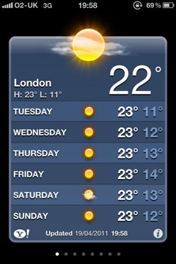
AN API DRIVEN APPLICATION

Slide 10
LAYOUT
IMAGES
TEXT
WEATHER DATA
INPUT HANDLING
APPLICATION LOGIC

Slide 11
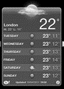
Frontend
(client)
Backend
(server)
Build page and send
LAYOUT
IMAGES
TEXT
INPUT HANDLING
WEATHER DATA
APPLICATION LOGIC

Slide 12

Frontend
(client)
Backend
(server)
DATA-CENTRIC API
WEATHER DATA
INPUT HANDLING
APPLICATION LOGIC
LAYOUT
IMAGES
TEXT

Slide 13





Frontend
(client)
Backend
(server)
DATA-CENTRIC API
WEATHER DATA
INPUT HANDLING
APPLICATION LOGIC
LAYOUT
IMAGES
TEXT

Slide 14
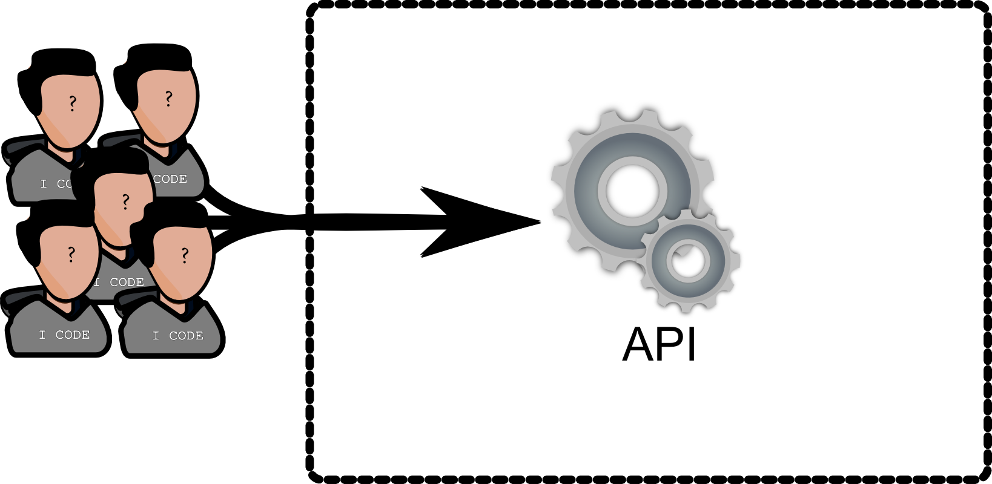

Slide 15
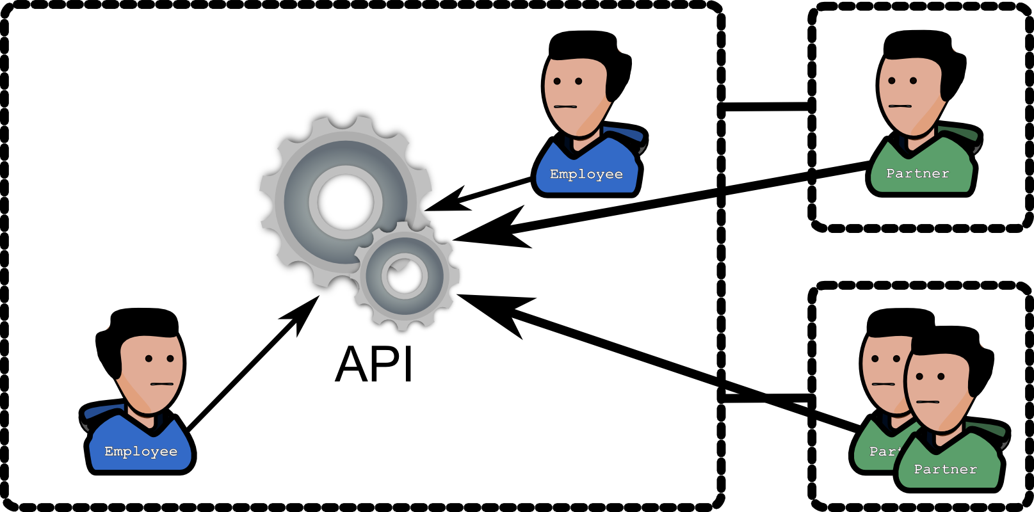

Slide 16



PRIVATE API
PUBLIC API
PARTNER API
Supports Your Own Applications
Supports 3rd Party Applications
Supports Your Partner’s Applications
Control the Application
Control the API Platform
Control the Relationship
Requires investment in application development
Move at the speed of the organization
Less risk to brand and organization
Requires greater investment in API platform
Move at the speed of the platform ecosystem
More freedom to innovate
Requires investment in relationship & procurement
Move at the speed of the partner ecosystem
Targeted growth and innovation

Slide 17
API Program Strategy
Notes:
What are we really talking without about here?

Slide 18
API Program Strategy
THE IDEA IN BRIEF
There are six significant objectives for API programs: revenue, growth, innovation, reach, intelligence and compliance
API programs vary greatly in scope, execution and effectiveness. There is no universal strategy for API programs.
An organization may launch more than one API product, but each should be focused on prioritized, business aligned objectives in order to return the most value
Banks must determine which objectives to focus on in preparation for the next wave of technology
We will use Alex Osterwalder’s Buiness Model Canvas to examine existing API business strategies

Slide 19
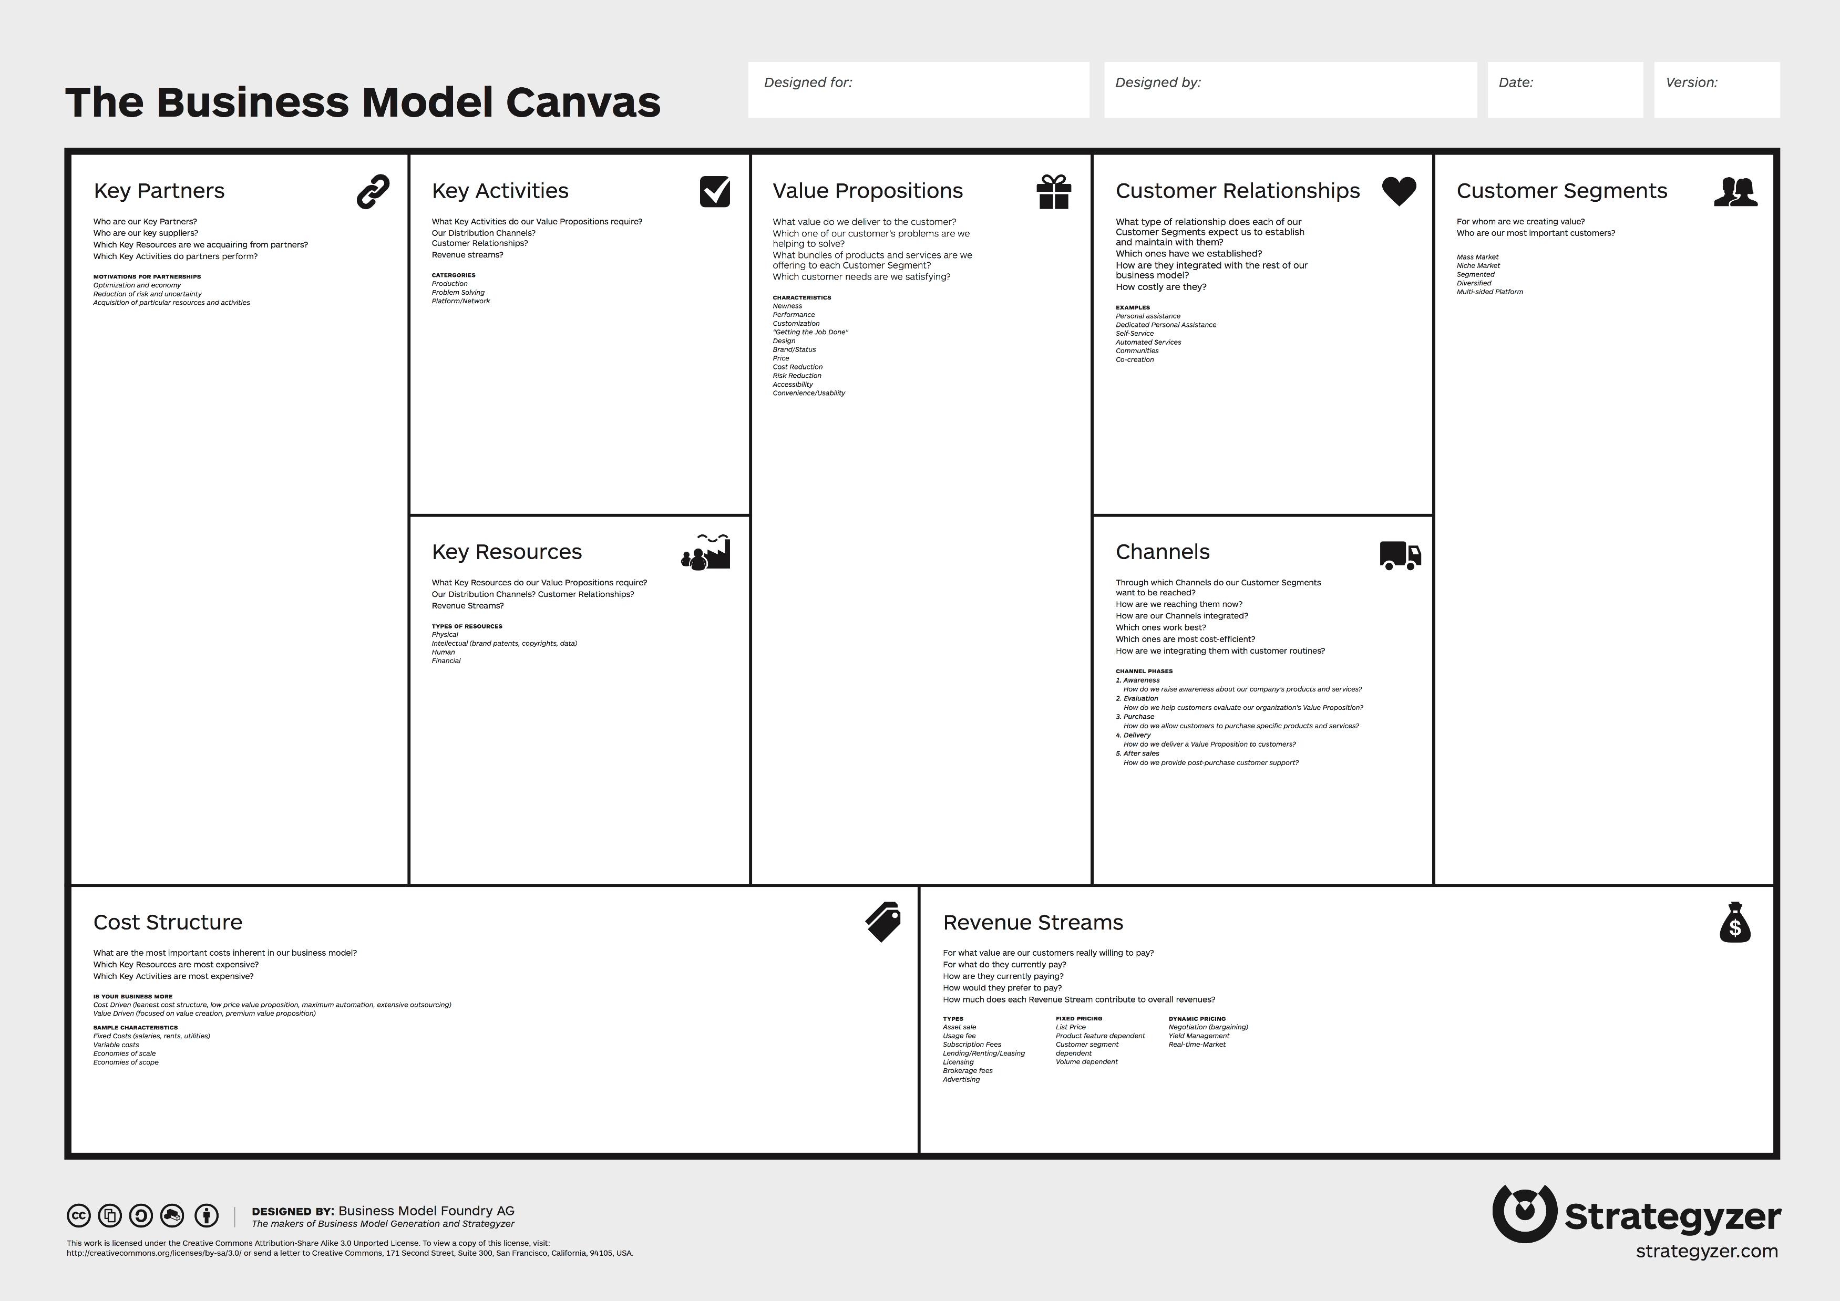
The Right Side
Delivering Value to Customers
Deriving Revenue

Slide 20
The Left Side
Value Creation
Cost Management

Slide 21
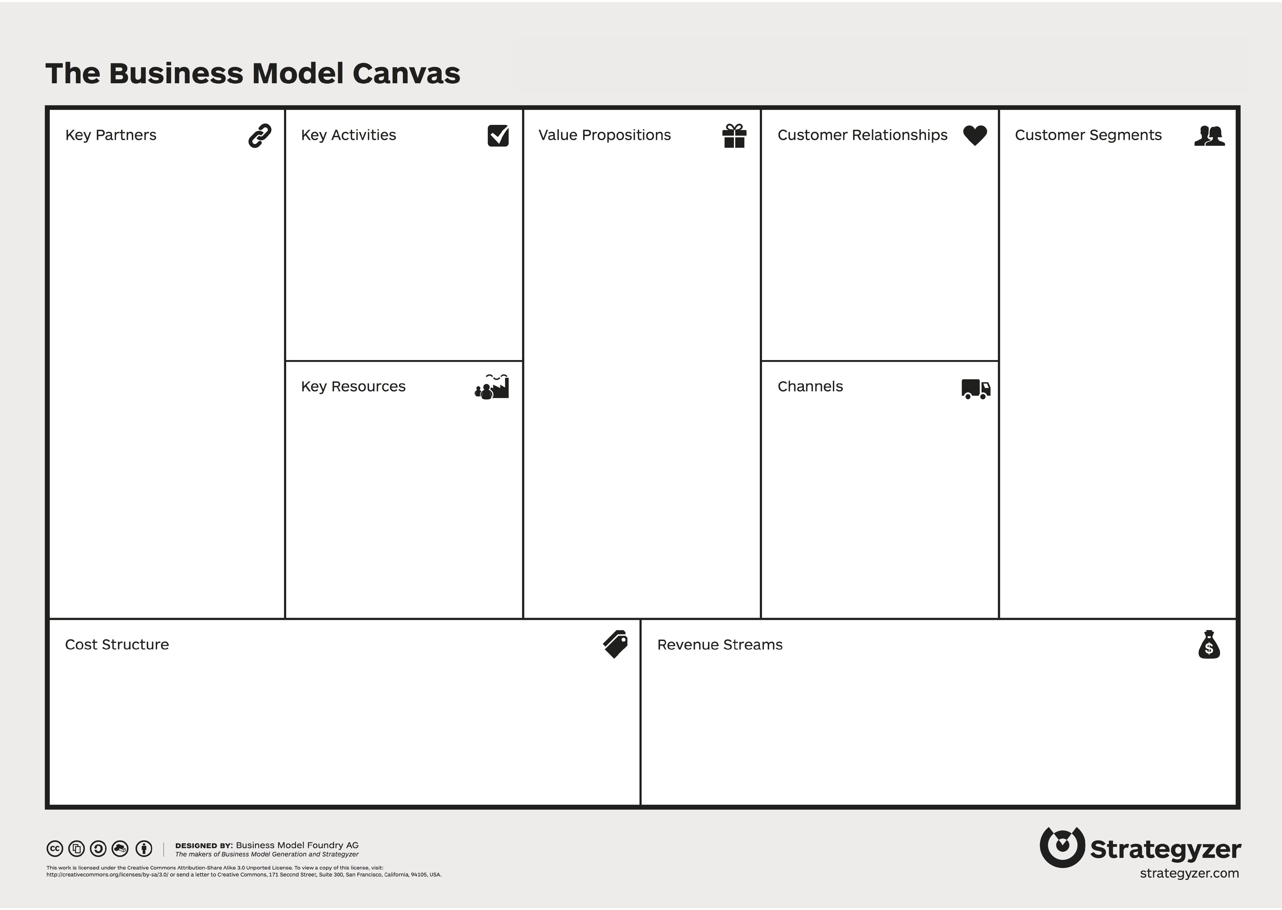
Public APIs: Delivering Value
API is the value proposition
Developers become customers

Slide 22
Public APIs: Delivering Value
app developer
API

Slide 23

Private APIs: Generating Value
API aids in value creation
Development is a key activity

Slide 24
Private APIs: Generating Value
value
API

Slide 25




revenue
reach
innovation
API PROGRAM DRIVERS
growth
compliance
intel
Notes:
Based on my own research and surveying of the API space, I’ve found that these six buckets are the most interesting at the moment. This isn’t an exhaustive list, but by studying examples of organizations that have used APIs to achieve each of these six goals we can start to form a clearer picture of the possibilities for our own organizations.

Slide 26
Case Studies Disclaimer
Examples are used only to illustrate API business drivers
These case studies are not an endorsement of any products, companies or services
These case studies are speculative and based solely on publicly available information

Slide 27
REVENUE

Slide 28
API Driver: Revenue
DEFINITION
Not just general revenue related activity
Deriving revenue directly from use of the API
Developers pay to use the API
“How can we make money from our data and APIs?”

Slide 29
API Driver: REVENUE
IN BRIEF
Treat the API like a product
Data and service monetization requires a valuable product and relevant customer segment
A continued investment in design, tooling, marketing and sales will be required to gain market share
Success attracts new entrants
Unless the data source is monopolized, expect commoditization of the market
Consider all models
Providing data and services to UX providers allows organizations like banks to derive revenue without large investments in product marketing

Slide 30
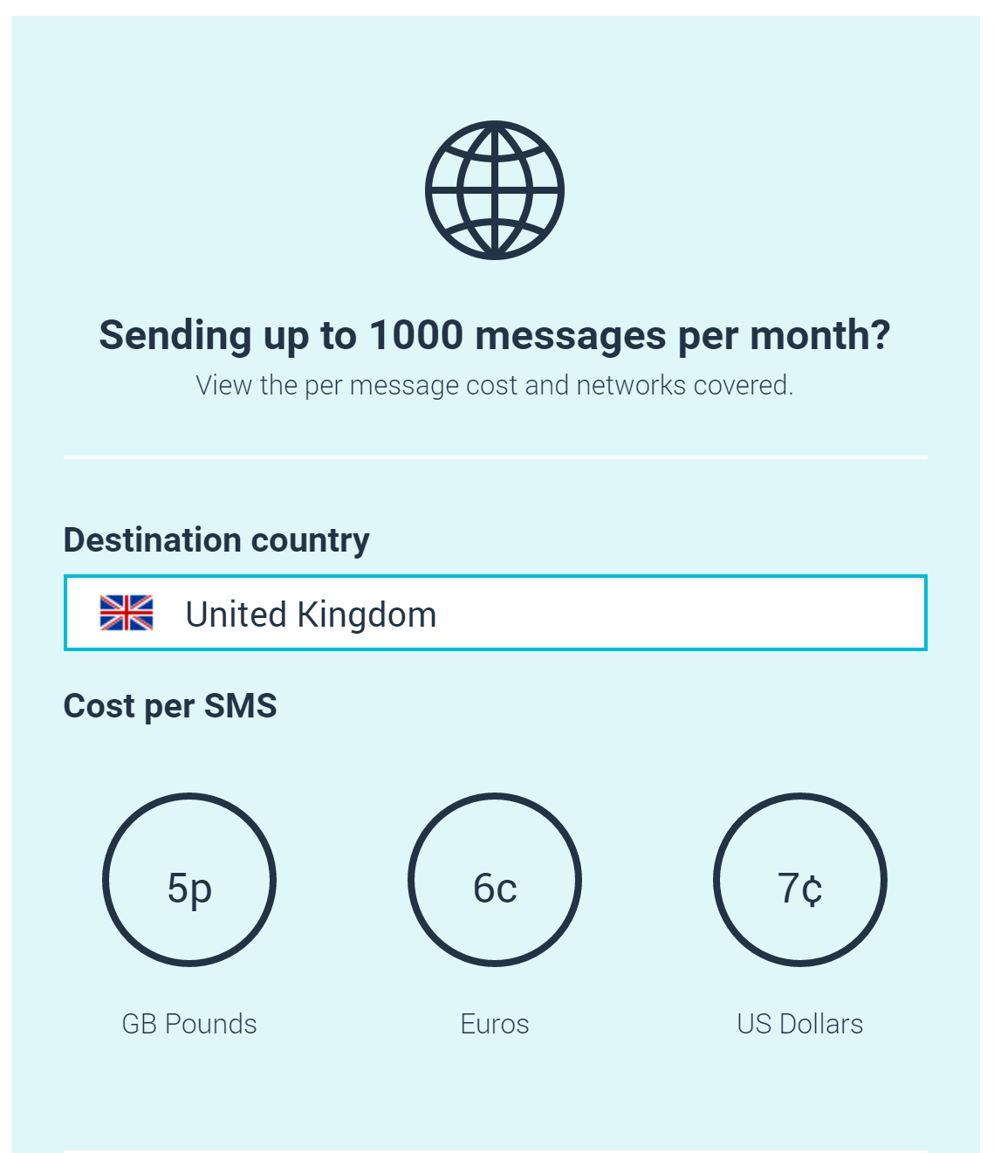
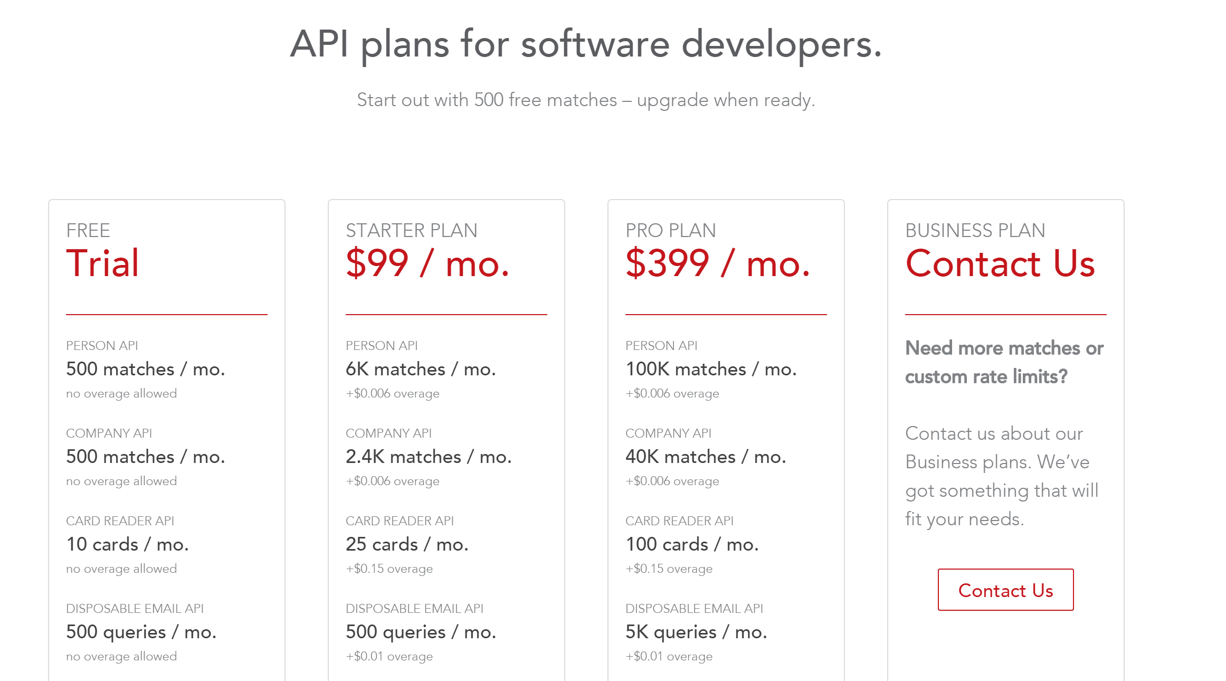
API Pricing Models
Notes:
Fullcontact api
Bizdev combined with revenue

Slide 31

“
Startups don’t fail because their technology doesn’t work, they fail because nobody wants what they are trying to build.
”
Eric Reiss
Lean Startup Creator

Slide 32

Revenue Driver Case Study

Slide 33
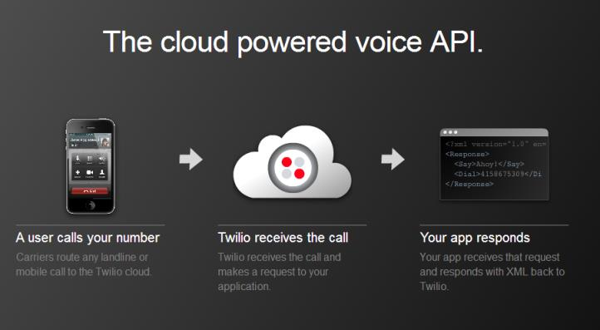
Twilio’s Product: APIs

Slide 34
Twilio in Context
Operates in a crowded marketplace
Not always the cheapest price
Large investment in developer engagement and experience

Slide 35
API Business Model
comm. services
app developer
simple and easy
call centre developer

Slide 36
API Business Model
comm. services
portal
app developer
simple and easy
evangelists
call centre developer
API
paid API Usage

Slide 37
API Business Model
platform dev
comm. services
portal
app developer
marketing
simple and easy
evangelists
call centre developer
evangelists
API
developers (internal)
platform development
marketing costs
paid API Usage

Slide 38
API Business Model
telecos
platform dev
comm. services
portal
app developer
marketing
simple and easy
evangelists
call centre developer
evangelists
API
developers (internal)
teleco Network
platform development
marketing costs
paid API Usage

Slide 39

Revenue Driver Case Study

Slide 40
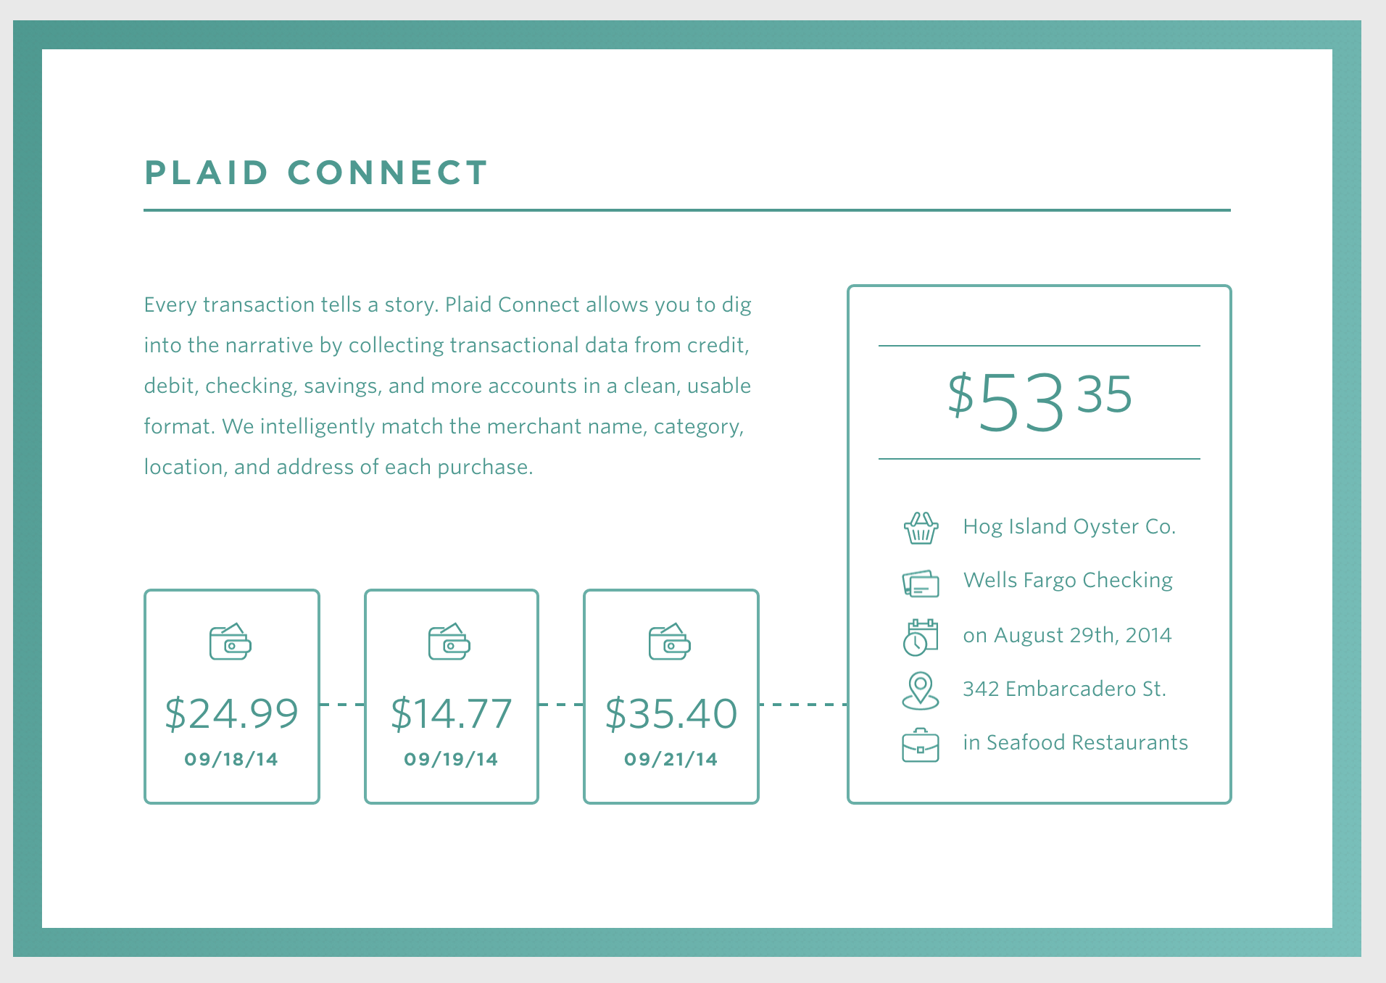
Plaid’s API Product

Slide 41



Many Existing Transactional Data API Companies

Slide 42
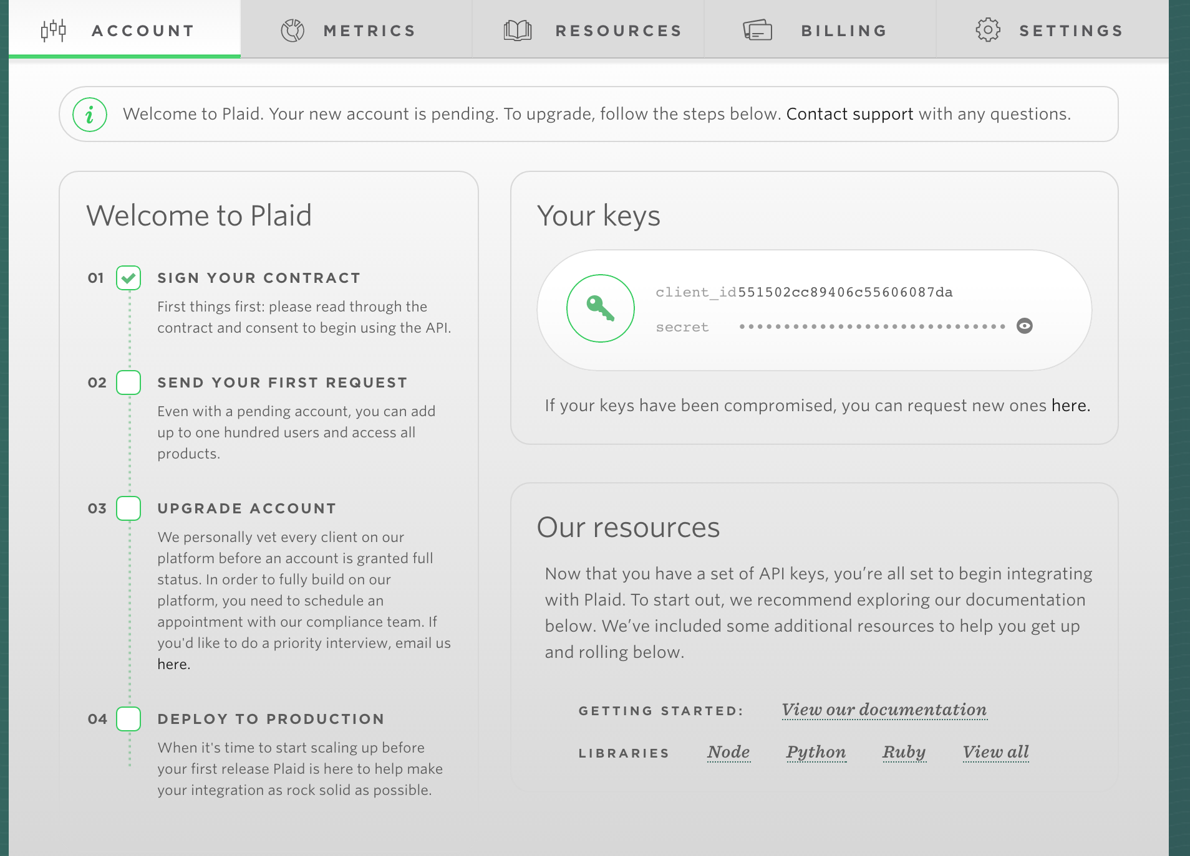
Plaid in Context
Applying the same model as Twilio:
Their value proposition is based on usability
Extreme focus on user experience
Powered by financial services APIs

Slide 43
API Business Model
financial data
platform dev
curated data
portal
app developer
marketing
simple and easy
API
developers (internal)
financial Network
platform development
paid API usage

Slide 44

Revenue Case Study

Slide 45
Twitter’s Revenue Model
users
advertisers
tweets
data resellers
twitter app
API
paid advertisements
data sales

Slide 46
Twitter’s Revenue Model
users
advertisers
tweets
data resellers
twitter app
API
paid advertisements
data sales

Slide 47





Twitter: Data Reseller Market (2014)
Firehose
API
Data Resellers
Data Consumer
Notes:
only four companies have firehose access. Apple purchased Topsy, Twitter ended up buying Gnip (in April) possible as a defensive move to retain some control of the reseller market

Slide 48
Twitter: Data Reseller Market (Today)
Resellers
Data Consumer
Notes:
only four companies have firehose access. Apple purchased Topsy, Twitter ended up buying Gnip (in April) possible as a defensive move to retain some control of the reseller market

Slide 49
Twitter’s Revenue Model: Vertical Integration
users
advertisers
tweets
analytics providers
twitter app
GNIP API
paid advertisements
data sales

Slide 50
GROWTH

Slide 51
API Driver: GROWTH
DEFINITION
Not just general revenue related activity
Deriving revenue directly from use of the API
Developers pay to use the API
“How can we make money from our data and APIs?”

Slide 52
API Driver: GROWTH
IN BRIEF
Offer value to 3rd party developers in exchange for new customers
Identify 3rd party communities and design a value prop for them
Consider public and partner models
Public APIs create more opportunities but decrease brand control
Consider all models
Providing data and services to UX providers allows organizations like banks to derive revenue without large investments in product marketing

Slide 53

Growth Case Study

Slide 54
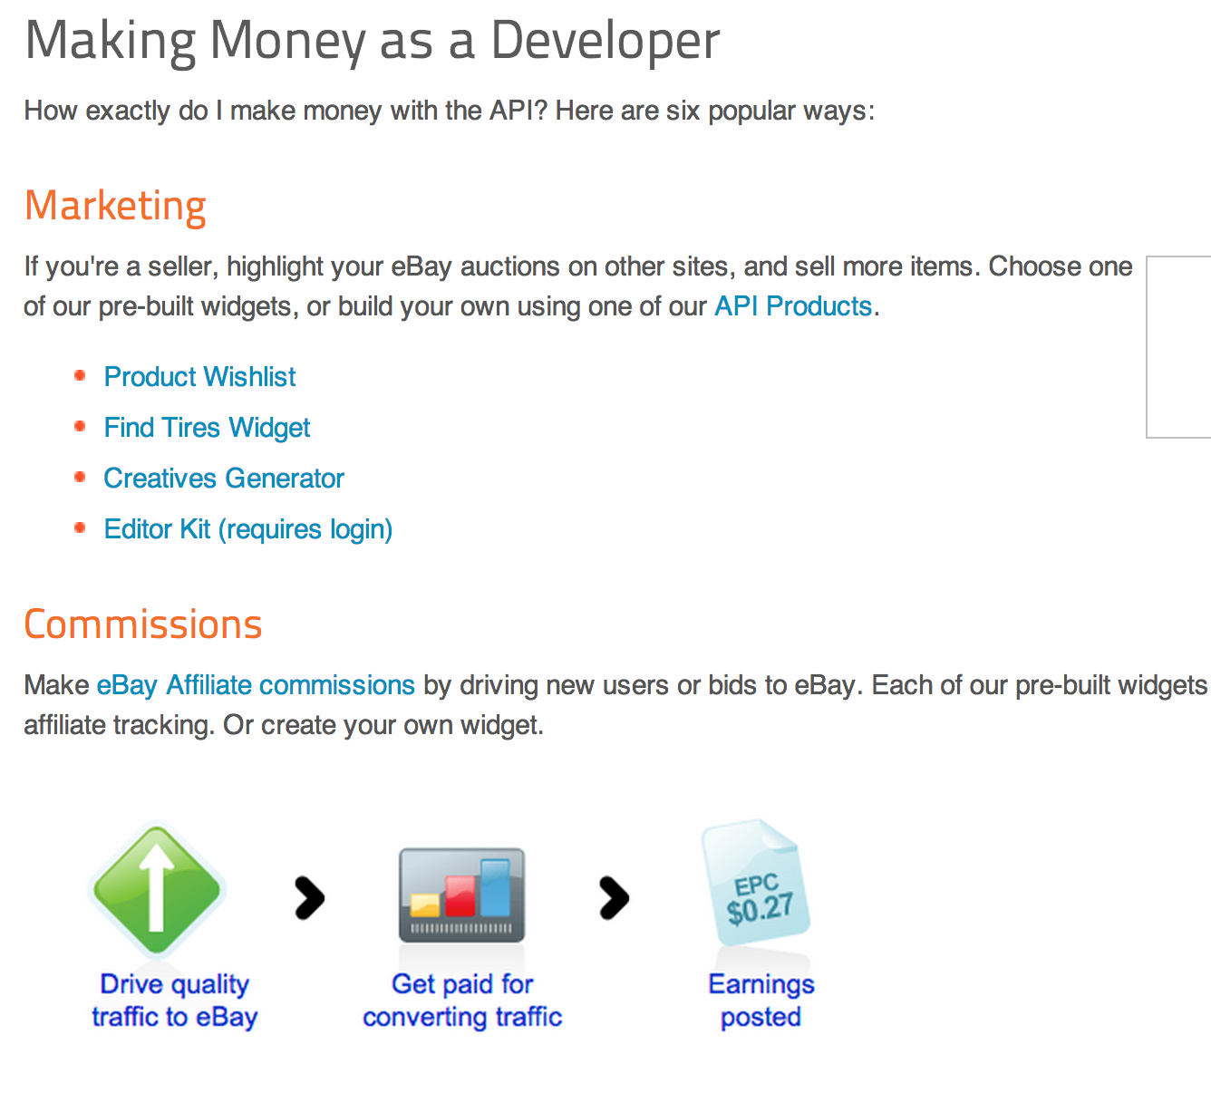
eBay Affiliate Program
Drive user growth through advertising
API provides a targeted marketing platform
eBay pays developers for bids created
Notes:
eBay’s affiliate program creates a network of sales people who can interact with eBay via the API. This allows them to drive growth by reaching more potential customers than they could on their own.

Slide 55
API Business Model
Interested buyers
sellers
products for sale
buyers
developers
auction platform
website
3rd party
API
platform tech
API
auction charge

Slide 56

Growth Case Study

Slide 57
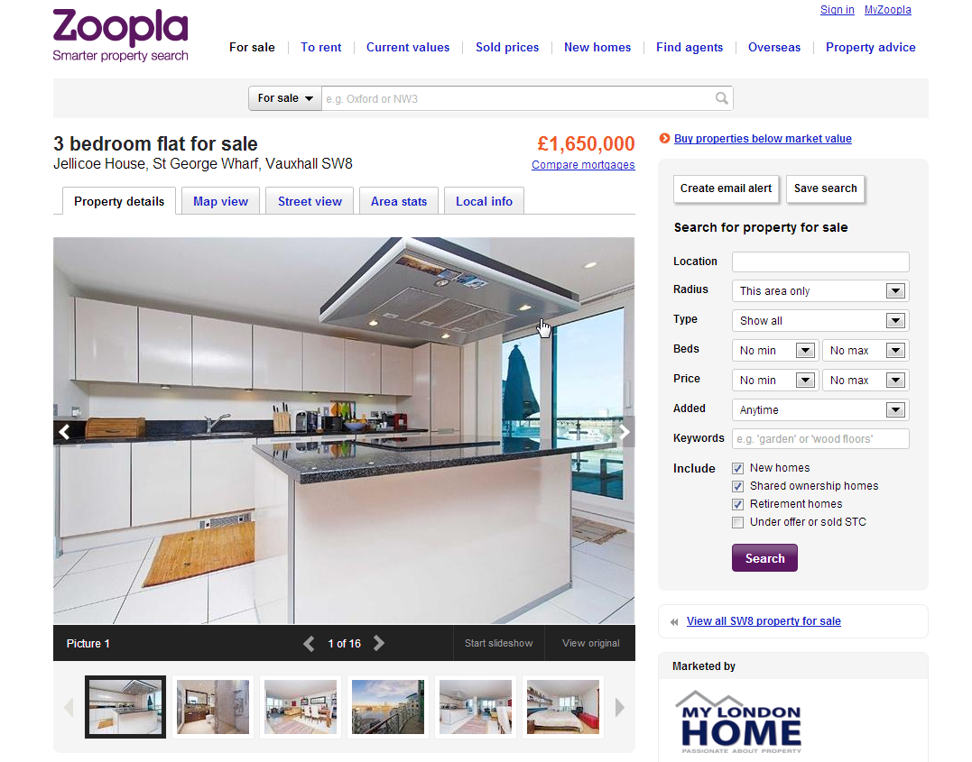
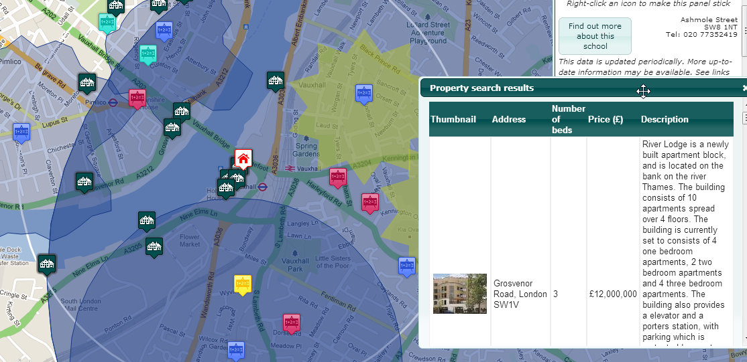
Zoopla: Using APIs for Growth

Slide 58
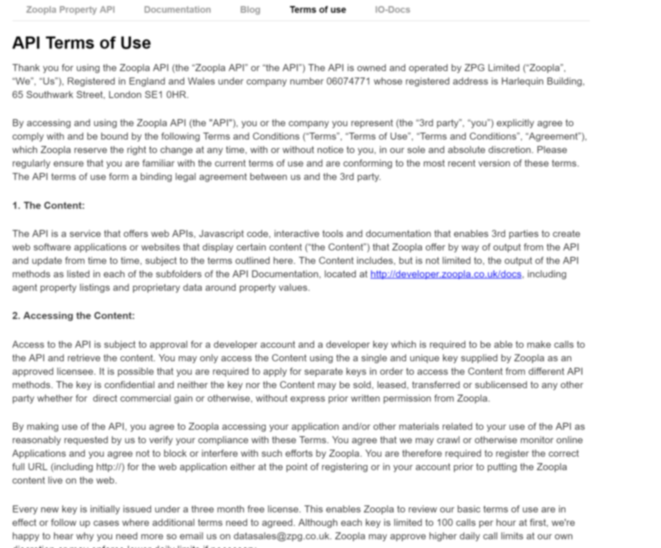
Zoopla API: TOS
“In cases where listings are on a 3rd party website, the content must link through to the original listing page on Zoopla and it is the 3rd party's responsibility to implement the “nofollow” HTML attribute to content and on these links.”
http://developer.zoopla.com/API_terms_of_use

Slide 59
A Zoopla Business Model
property listings
self-service
buyers
interested buyers
3rd Party Apps
estate agents
website
users
subscription

Slide 60

Growth Case Study

Slide 61
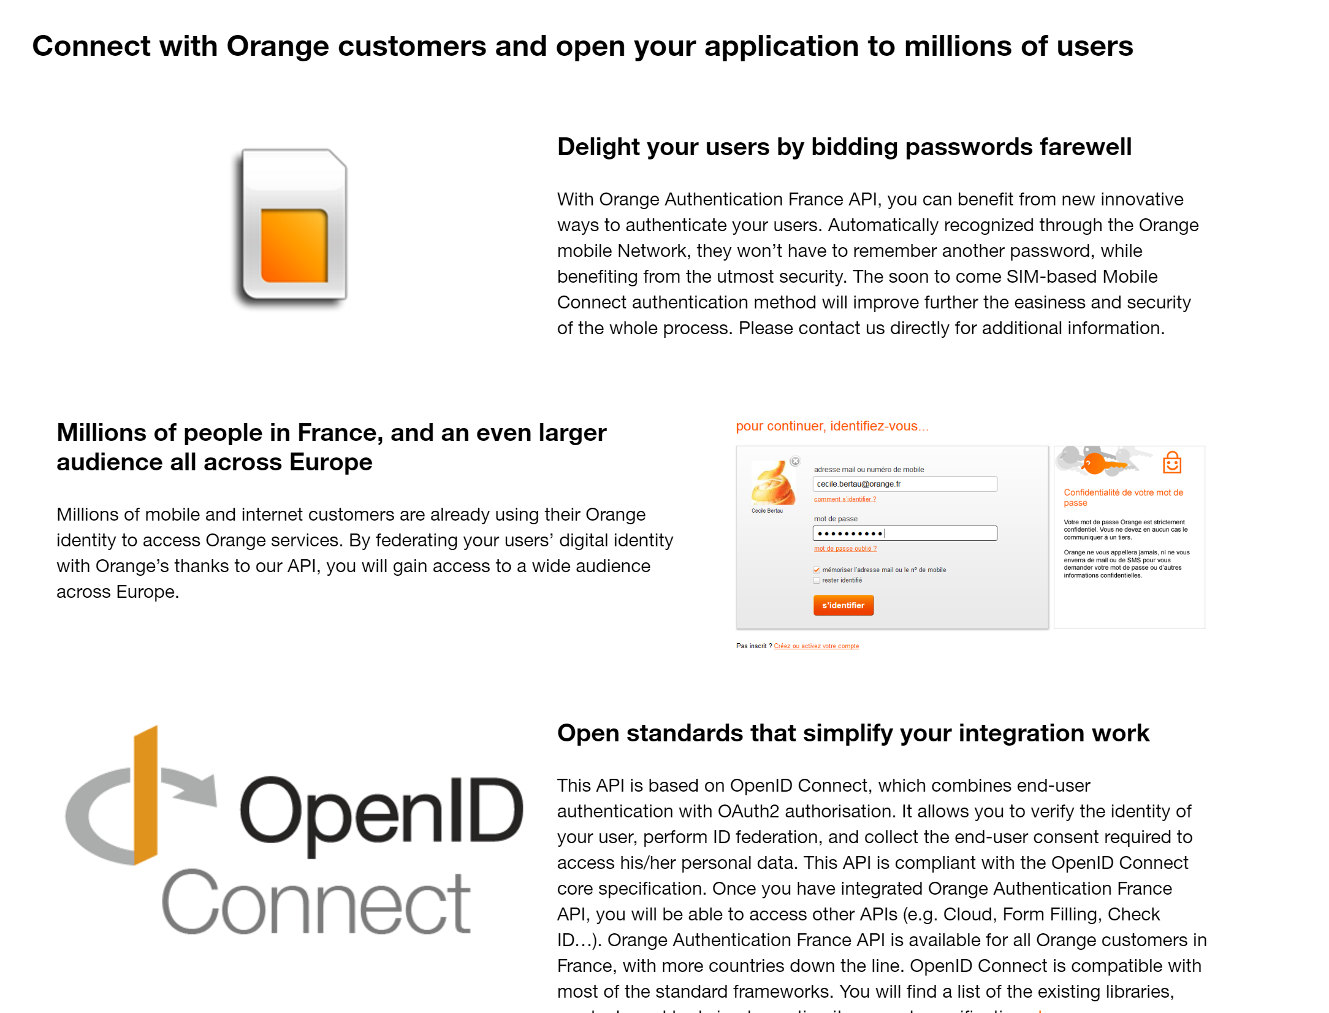
orange: Authentication API

Slide 62
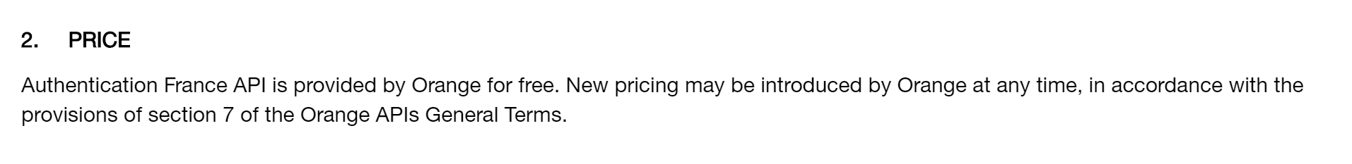
orange: Authentication API

Slide 63
An Orange Authentication API Business Model
convenience
orange
customers
safety
3rd party form / app
paid subscriptions
Notes:
The idea might be that Orange hopes to increase their mobile subscription base by offering identity as a service for free. Customers gain the convenience of auto-filled in forms, so they are inclined to stay with Orange vs moving to another company.
But, this type of market is very competitive and users are far more likely to get this advantage from ‘free’ services such as twitter or google.

Slide 64

Growth Case Study

Slide 65
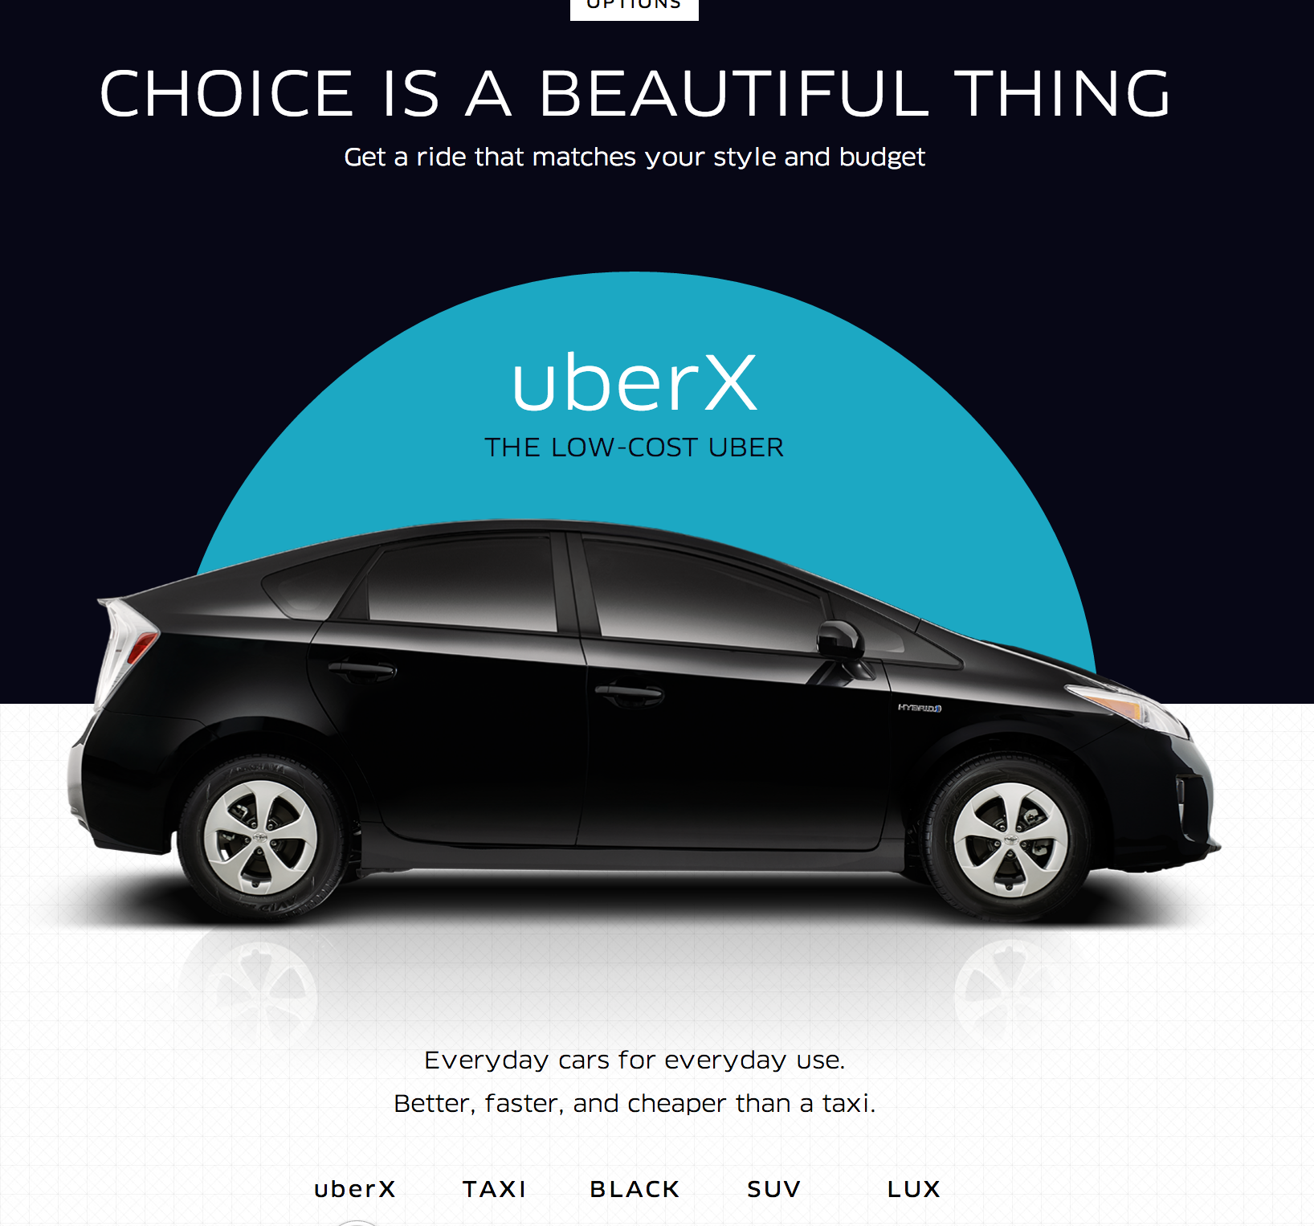
Uber: A product for riders and drivers

Slide 66
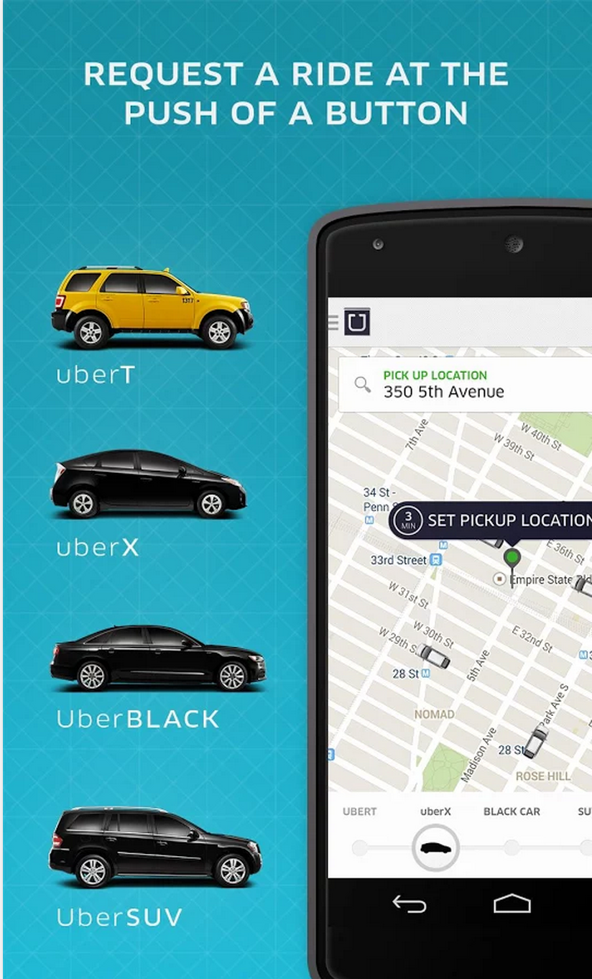
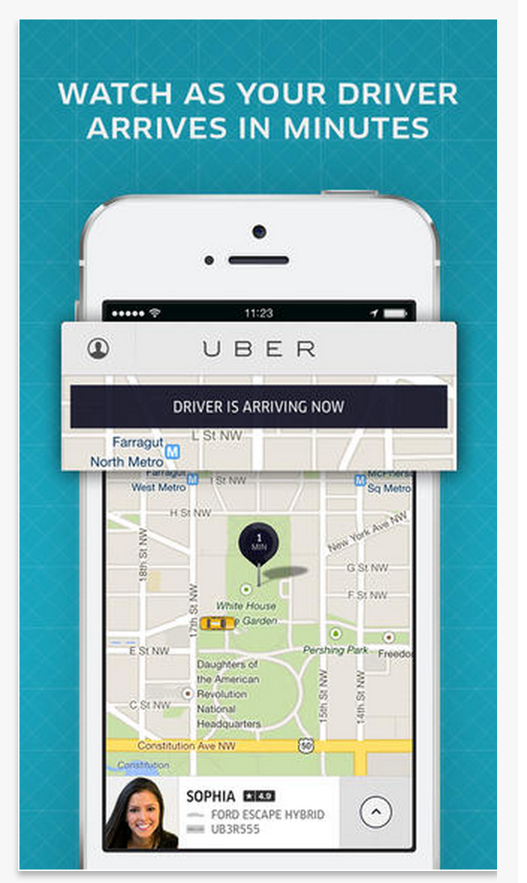

Uber Native Experiences
Mobile App and convenience focus
“Just push a button”

Slide 67
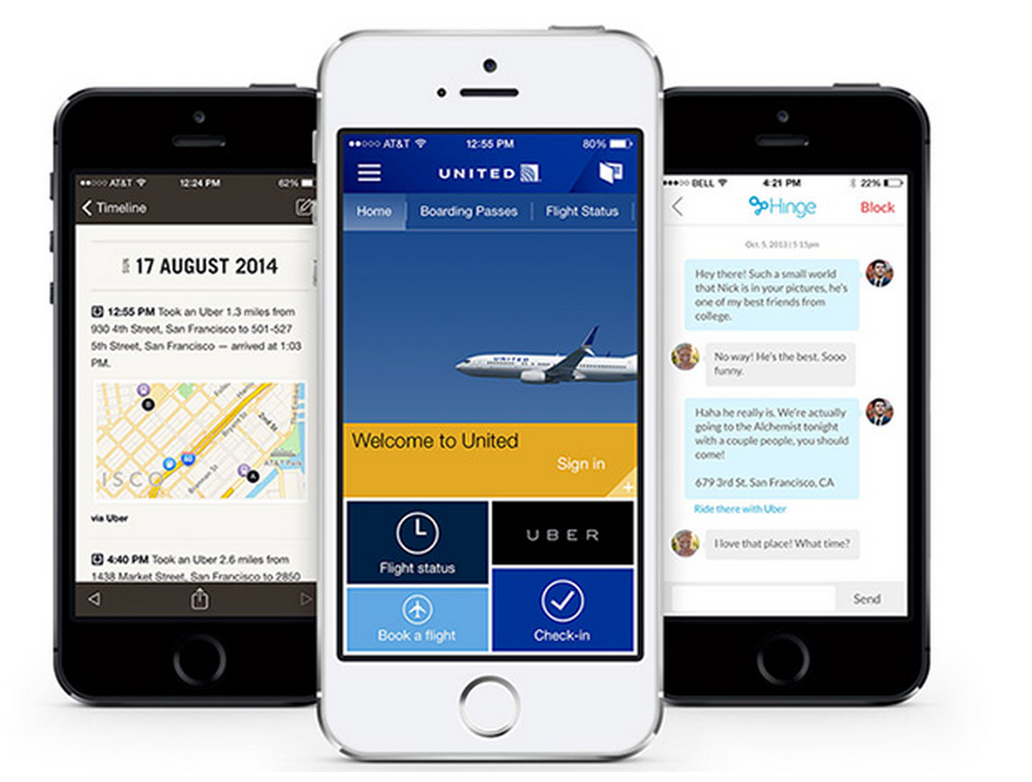
Driving growth with partnerships
API provides value for travel & tourism app developers
API allows Uber to reach new pools of customers
Notes:
Uber’s headstart in the market is allowing them to extend their reach to a whole new set of end users and in ways that will drive massive amounts of revenue.

Slide 68
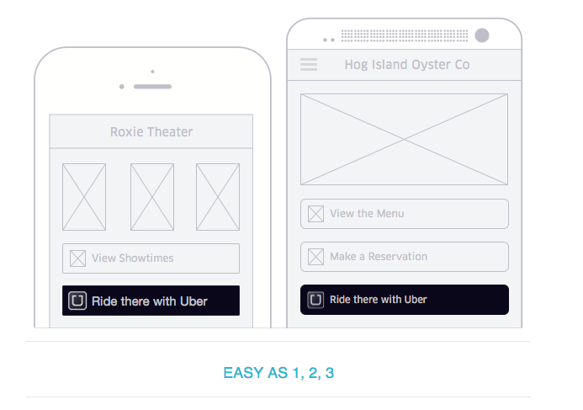
Uber: Deep Linking

Slide 69
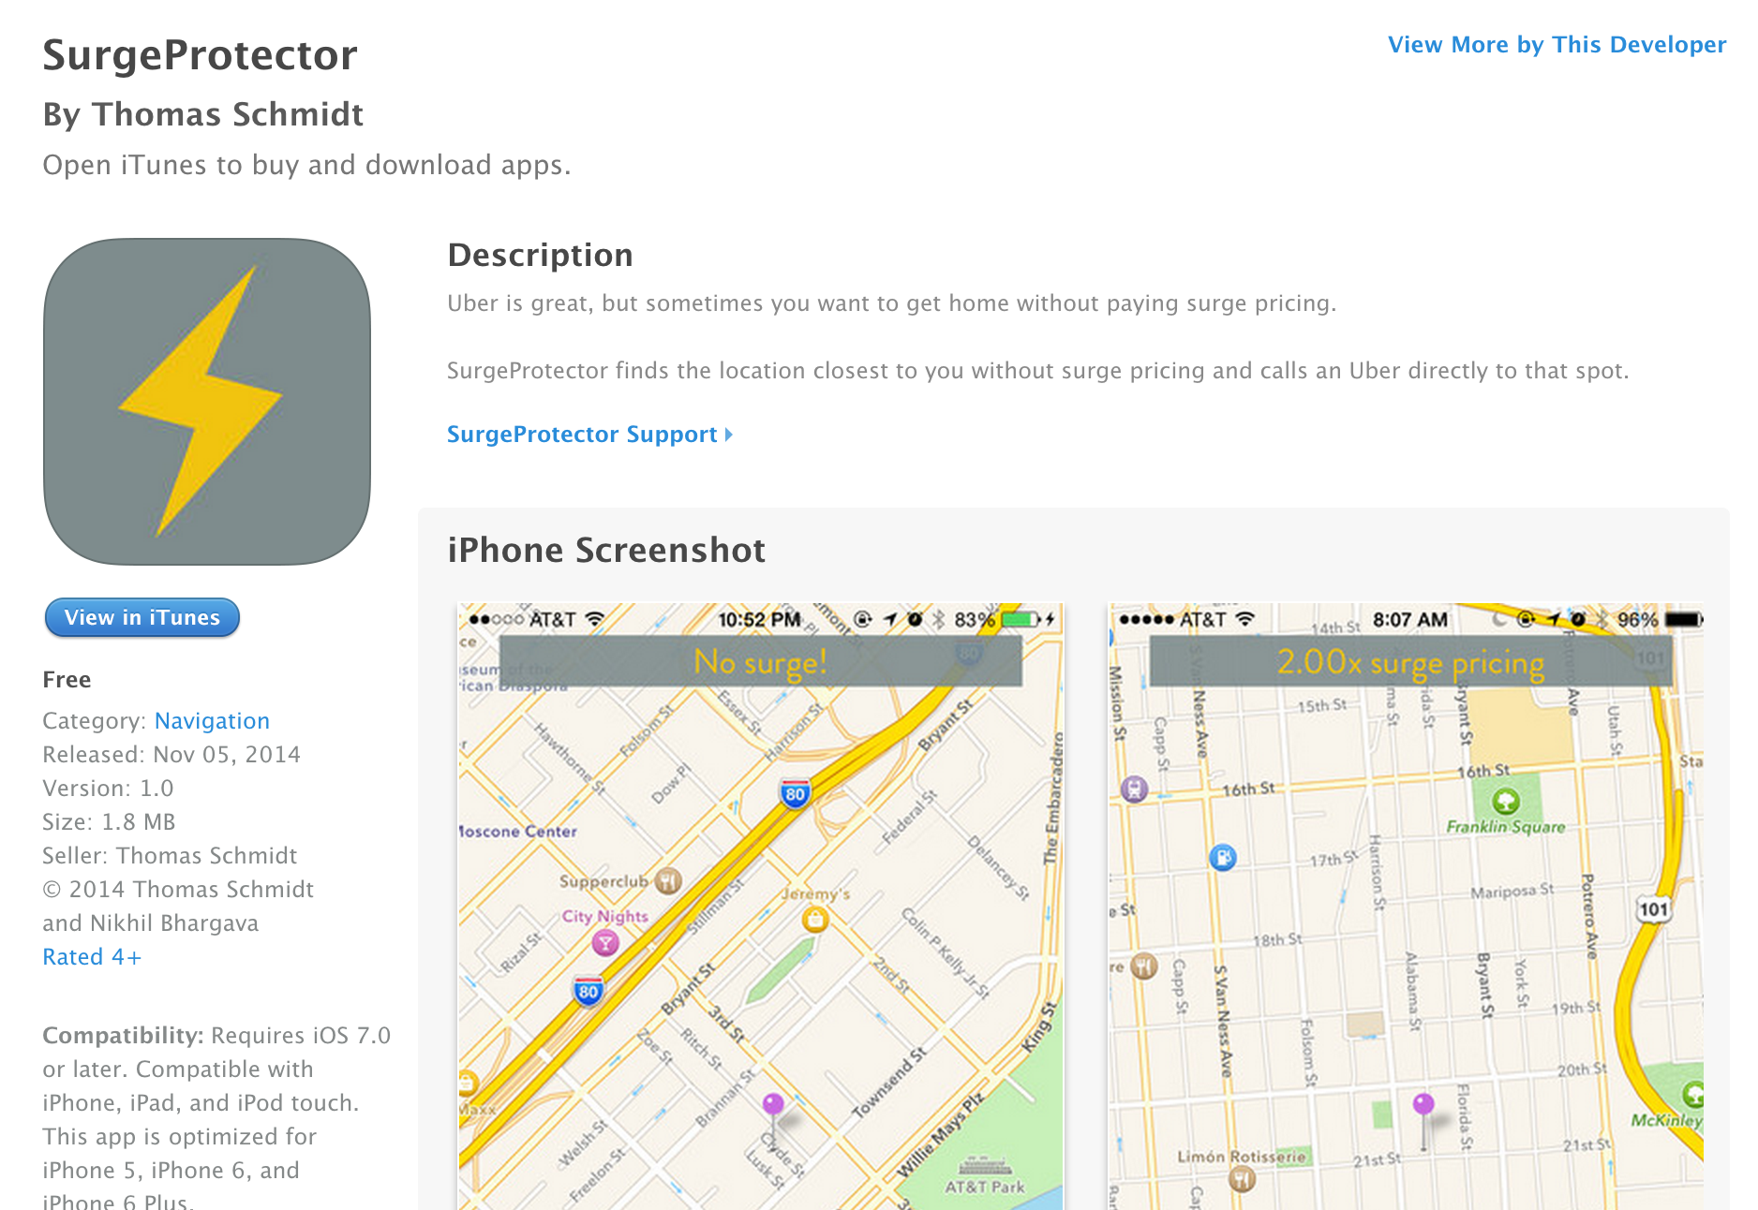
Uber API

Slide 70
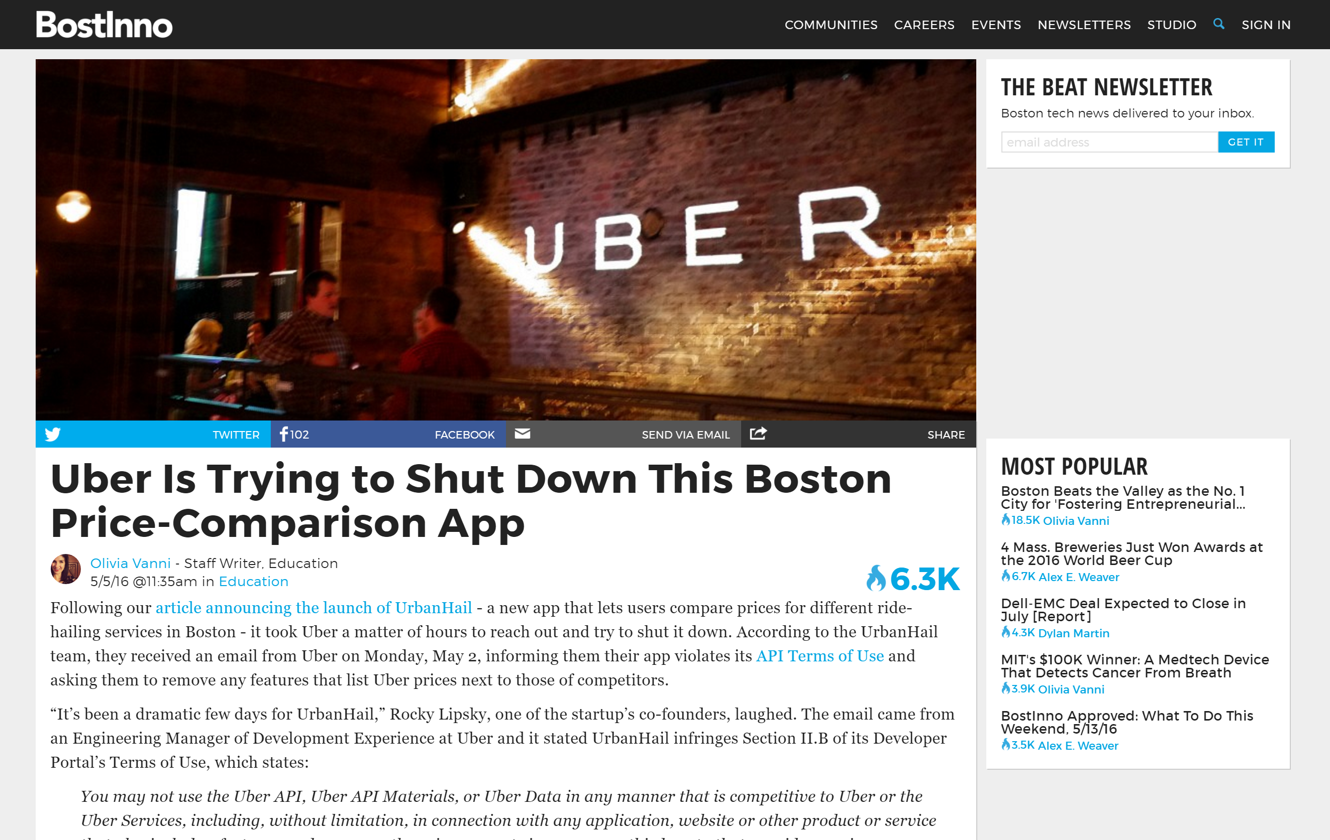
Uber API

Slide 71
An Uber API Business Case
riders
drivers
cars
passengers
uber app
uber button
ride transactions

Slide 72
REACH

Slide 73
API Driver: REACH
DEFINITION
Reach existing customers
Build new user experiences
Increase the contact surface for products (e.g. omnichannel)
“How can we provide great experiences to all of our users?”

Slide 74
API Driver: REACH
IN BRIEF
A fragmented UX space requires a large investment in application development
Public APIs can increase opportunities to reach customers
API scope must be carefully defined to prevent degradation of a core businesses’ value

Slide 75

Reactive interfaces
There is no universal platform
There is no standard screen size

Slide 76

Consumer experiences are fragmented
Notes:
Talk about taking over new markets.
Talk about plethora of devices.
Talk about apps as platforms. How do you reach a user who doesn’t know who you are?

Slide 77
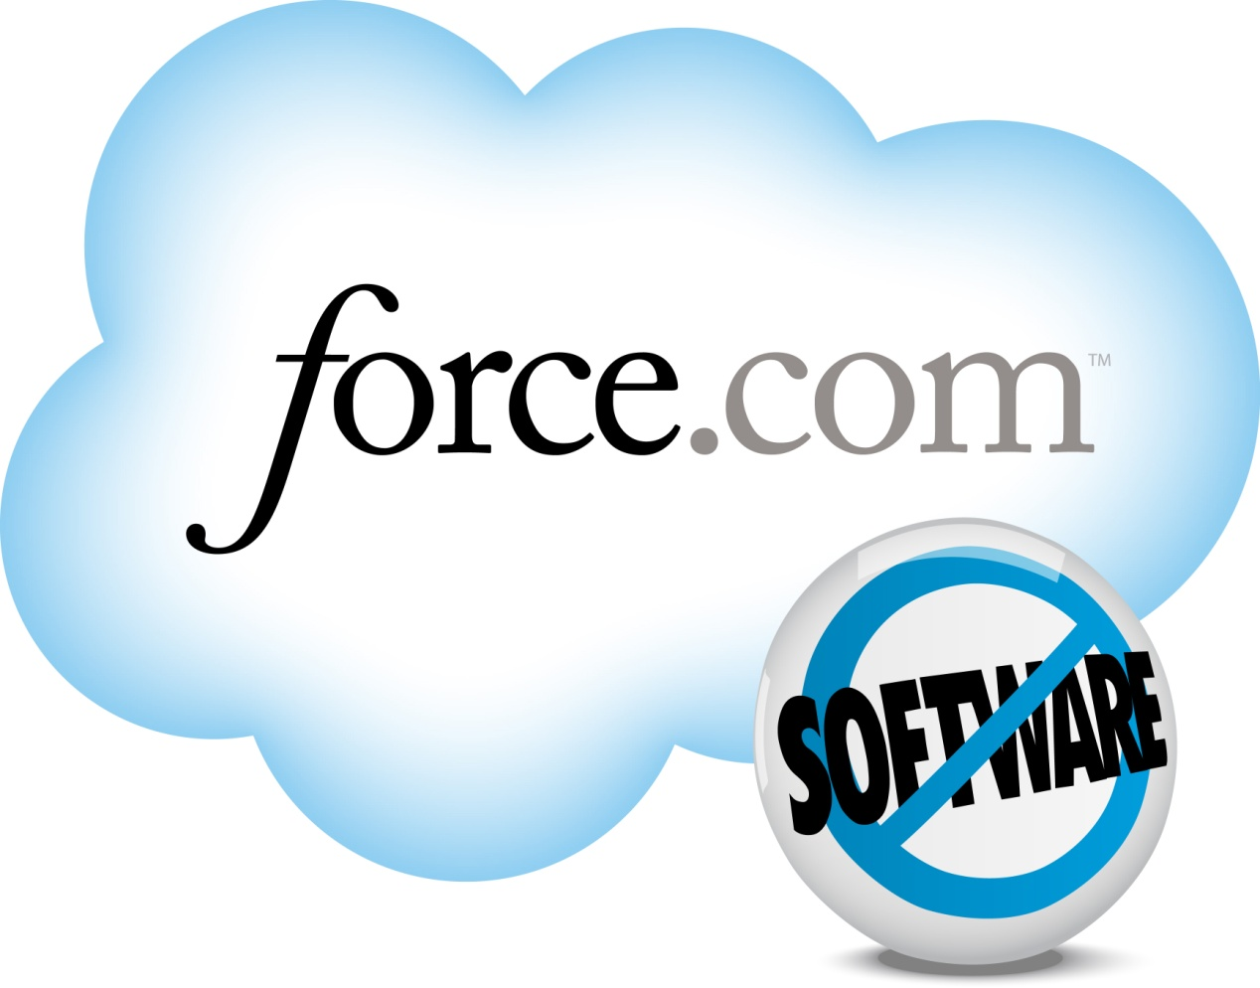



Reach Software, Media and Social Communities

Slide 78
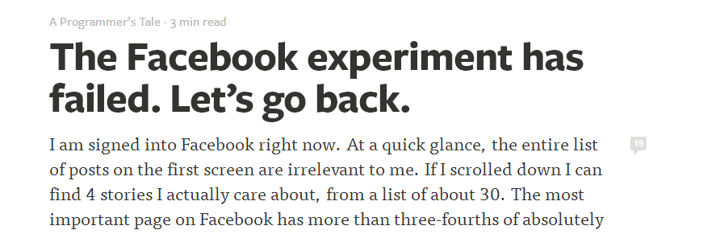
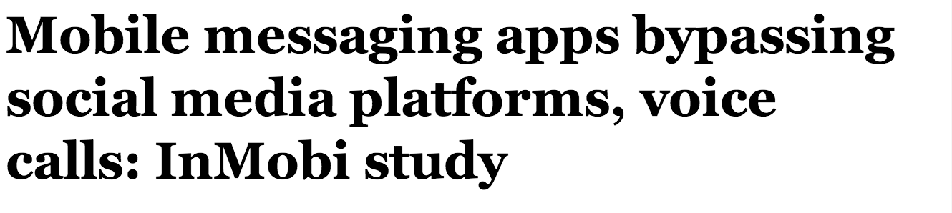
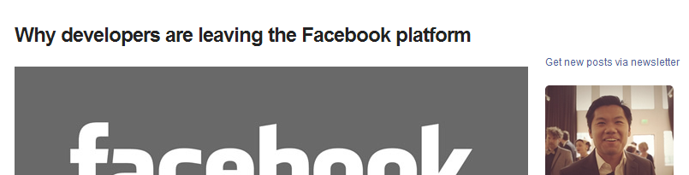
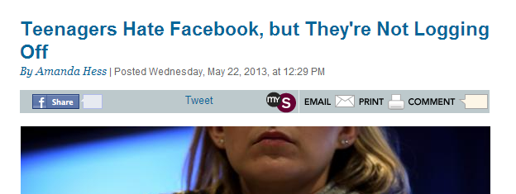
Platforms are not forever!

Slide 79
Why is Reach Difficult?
Good UX is a high investment, highly contextual activity
User touchpoints have proliferated
Reaching all users is too costly for most organizations

Slide 80
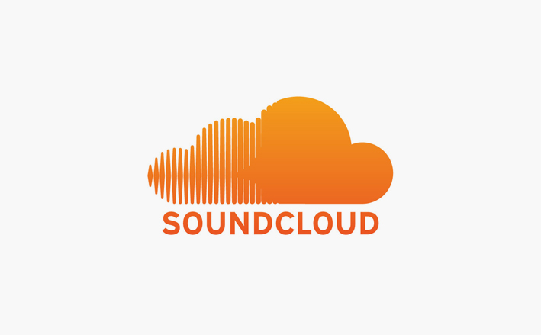
Reach Case Study

Slide 81
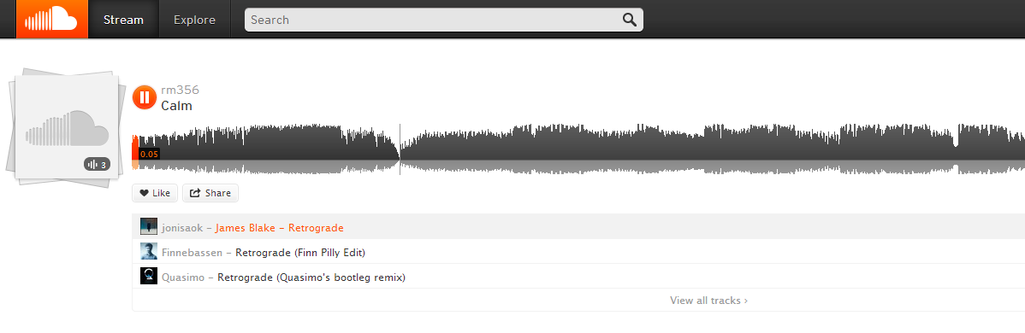
Soundcloud
Music sharing community
“Youtube of audio”

Slide 82
A Soundcloud Business Model
active listeners
audio producers
audio catalog
audio consumers
great UX
app / site
listeners
subscription

Slide 83
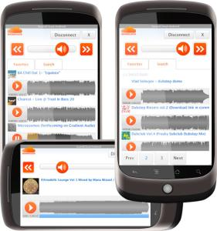
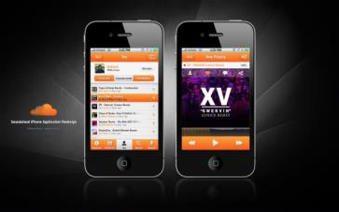


Soundcloud Apps

Slide 84
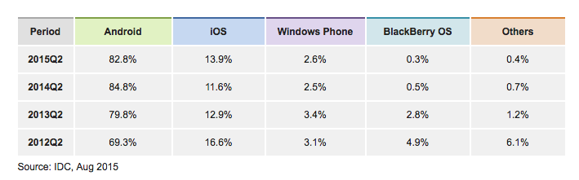
Mobile OS Marketshare

Slide 85
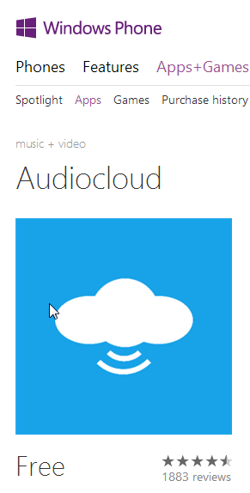
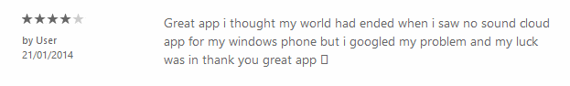
A Windows Phone Soundcloud App

Slide 86

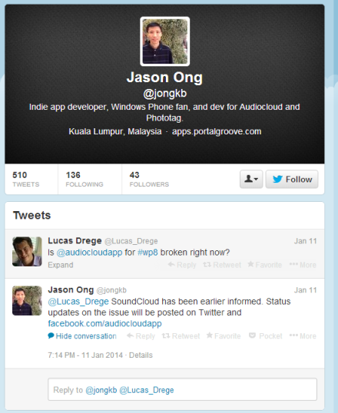
3rd Party App Developer

Slide 87

“
[…] because there isn't an official SoundCloud client on the WP platform.
”
Jason Ong
Windows Phone App Developer

Slide 88
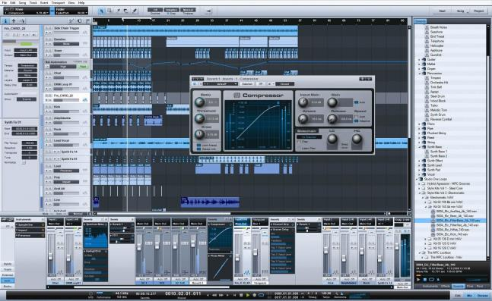
Another SoundCloud App

Slide 89
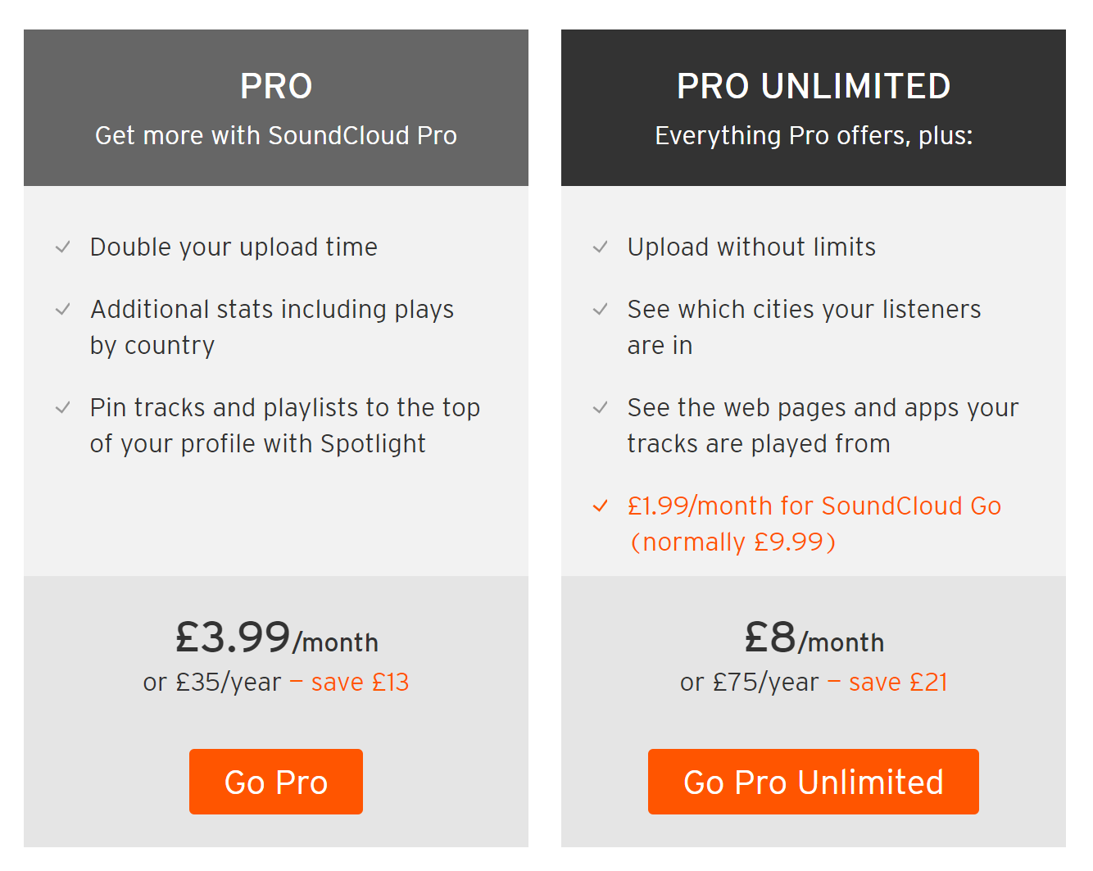
Soundcloud API Scope
Included in the soundcloud API:
User profiles, playlists, playback, social
Not Included:
Statistics and analytics

Slide 90
A Soundcloud Business Model
active listeners
audio producers
audio catalog
audio consumers
great UX
3rd party devs
great DX
app / site
API
listeners
subscription
apps

Slide 91

Reach Case Study
Notes:
Fee-Dor

Slide 92
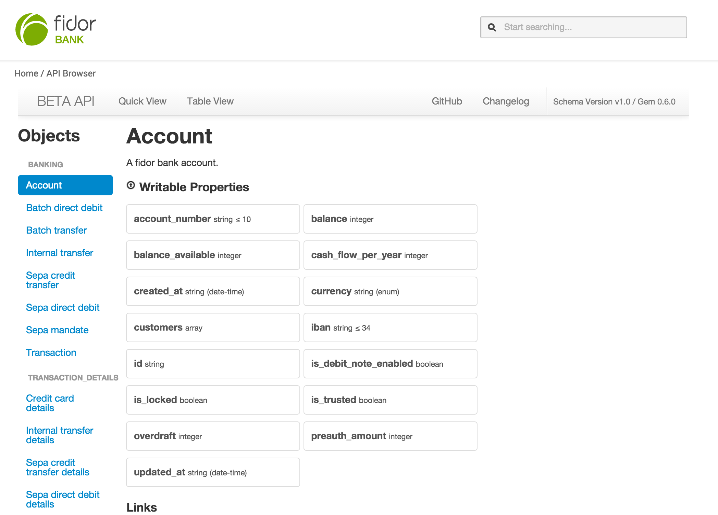
Fidor Bank API

Slide 93
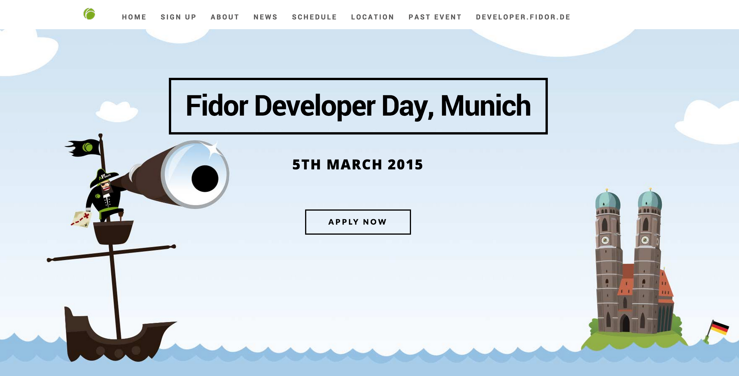
Fidor Developer Engagement

Slide 94
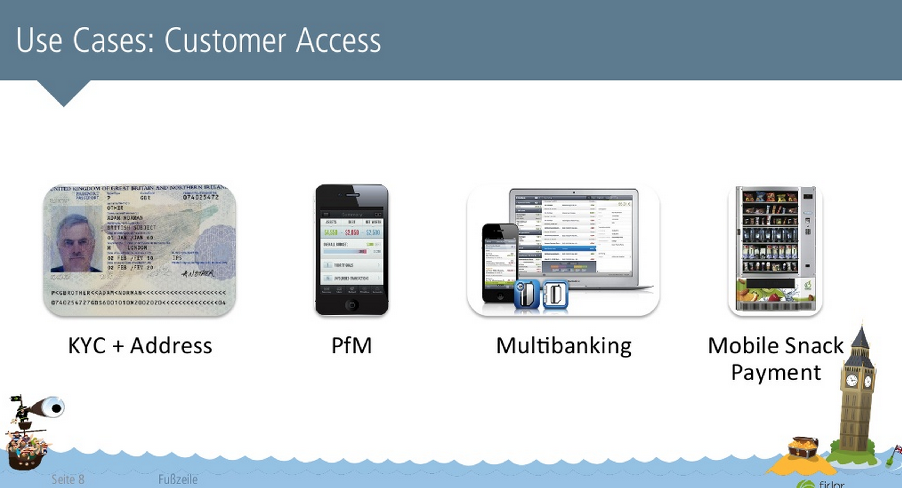
Fidor Reach
Source: http://www.slideshare.net/Ficoba/introducing-fidor-apis-developer-day-london-2014

Slide 95
Speculating on Fidor API Motivations
They understand that APIs are the digital surface for reach
The API can drive innovative UX that may act as a differentiator
They want to disrupt banking

Slide 96
A Fidor Business Model
loan products
borrowers
savings products
savers
security
branches
apps

Slide 97
A Fidor Business Model
loan products
borrowers
savings products
savers
security
devs
Fidor apps
convenience
3rd party apps
API

Slide 98
INNOVATION

Slide 99
API Driver: Innovation
DEFINITION
Facilitating innovation activities
“How can we continue to deliver the most valuable products and experiences?”

Slide 100
API Driver: Innovation
IN BRIEF
Innovation from the outside requires an investment in both idea acquisition and idea development
Innovation from the inside requires an investment in both idea generation and idea execution
Innovation driven API programs can reduce the cost and increase the opportunity for innovation in organizations

Slide 101
Innovation in Business
Changing marketplaces
Changing consumer attitudes
Pursuit of better

Slide 102
Enabling Innovation
Get better at generating ideas
Get better at executing on ideas
Two innovation sources:
Outside
Inside

Slide 103
Innovation From The Outside
Ideas generated from outside the organization boundaries
A different perspective, unique point of view
Crowdsourced ideas and innovations

Slide 104

A Recipe for API-Centric External Innovation
Open an API to expose data and services
Run a “hackathon”
See what blooms and profit
Notes:
On “thoussand flowers”:
The full quotation, taken from a speech of Mao's in Peking in February 1957, is:
"Letting a hundred flowers blossom and a hundred schools of thought contend is the policy for promoting progress in the arts and the sciences and a flourishing socialist culture in our land."
It is sometimes suggested that the initiative was a deliberate attempt to flush out dissidents by encouraging them to show themselves as critical of the regime. Whether or not it was a deliberate trap isn't clear but it is the case that many of those who put forward views that were unwelcome to Mao were executed.

Slide 105

Typical Results
Notes:
Many APIs that started as being innovation driven had to pivot because it turned out that there weren’t hundreds of great ideas waiting to be harvested. Innovation requires strong motivation, persistence, focus and hard work. Finding ideas by simply opening up an API turned out not to be enough.
Usually you end up with lots of fun experiments, but not a whole lot that can be harvested into real business value.
This type of driver can still be pursued and businesses can reap rewards, but organizations must realize that the cost of fostering innovation (even from external forces) is high.

Slide 106
APIs for Outside Innovation: Challenges
Difficult to budget for innovation – when will it happen?
What happens when innovative ideas are discovered?
How are developers incentivized? What’s in it for them?

Slide 107

Innovation Case Study
Notes:
Fee-Dor

Slide 108
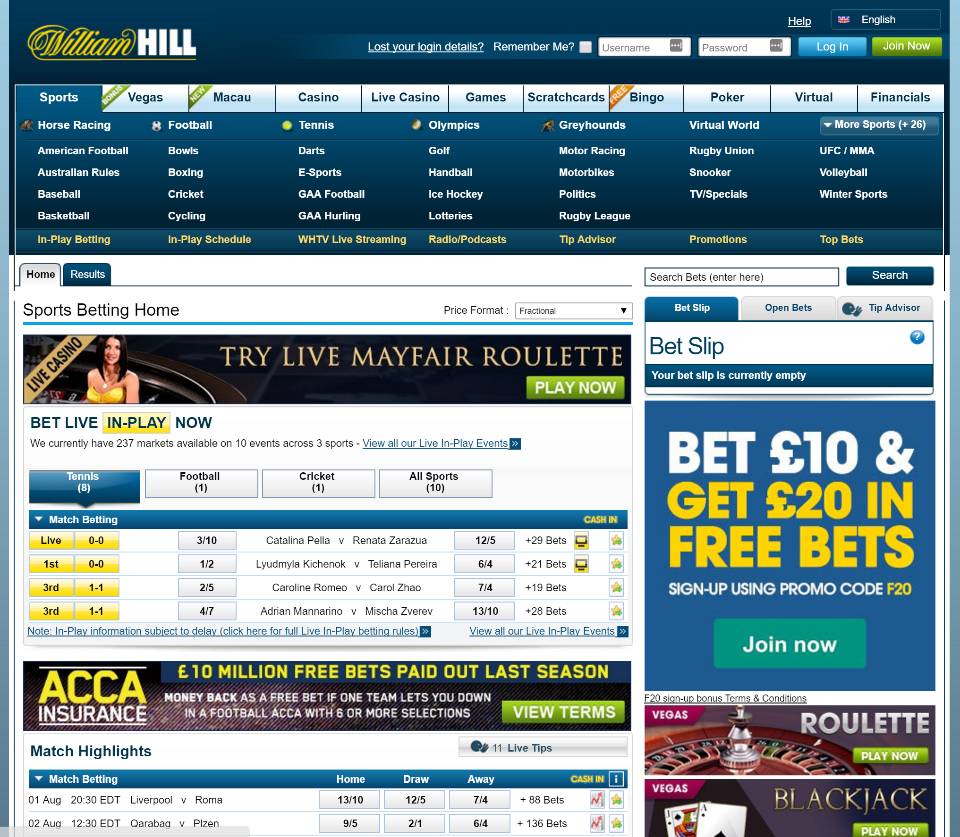
William Hill

Slide 109
William Hill in Context
Operating in a highly competitive, commoditized marketplace (gaming)
Unique and new user experiences are a key product differentiator
Identifying “blue water” audiences and gaming markets is a key innovation activity

Slide 110
A William Hill Business Model
earning potential
gamblers
enjoyment
branches
apps

Slide 111
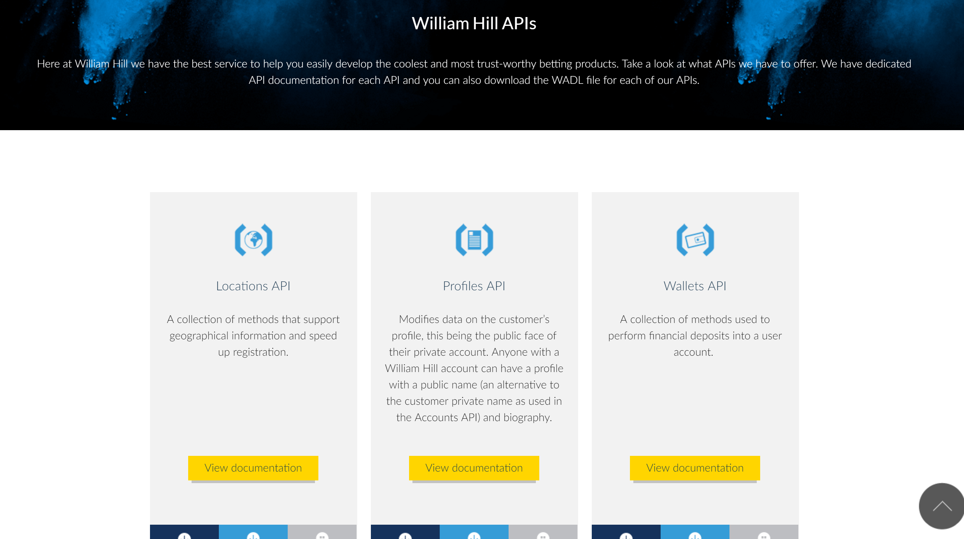
William Hill : 10 APIs

Slide 112
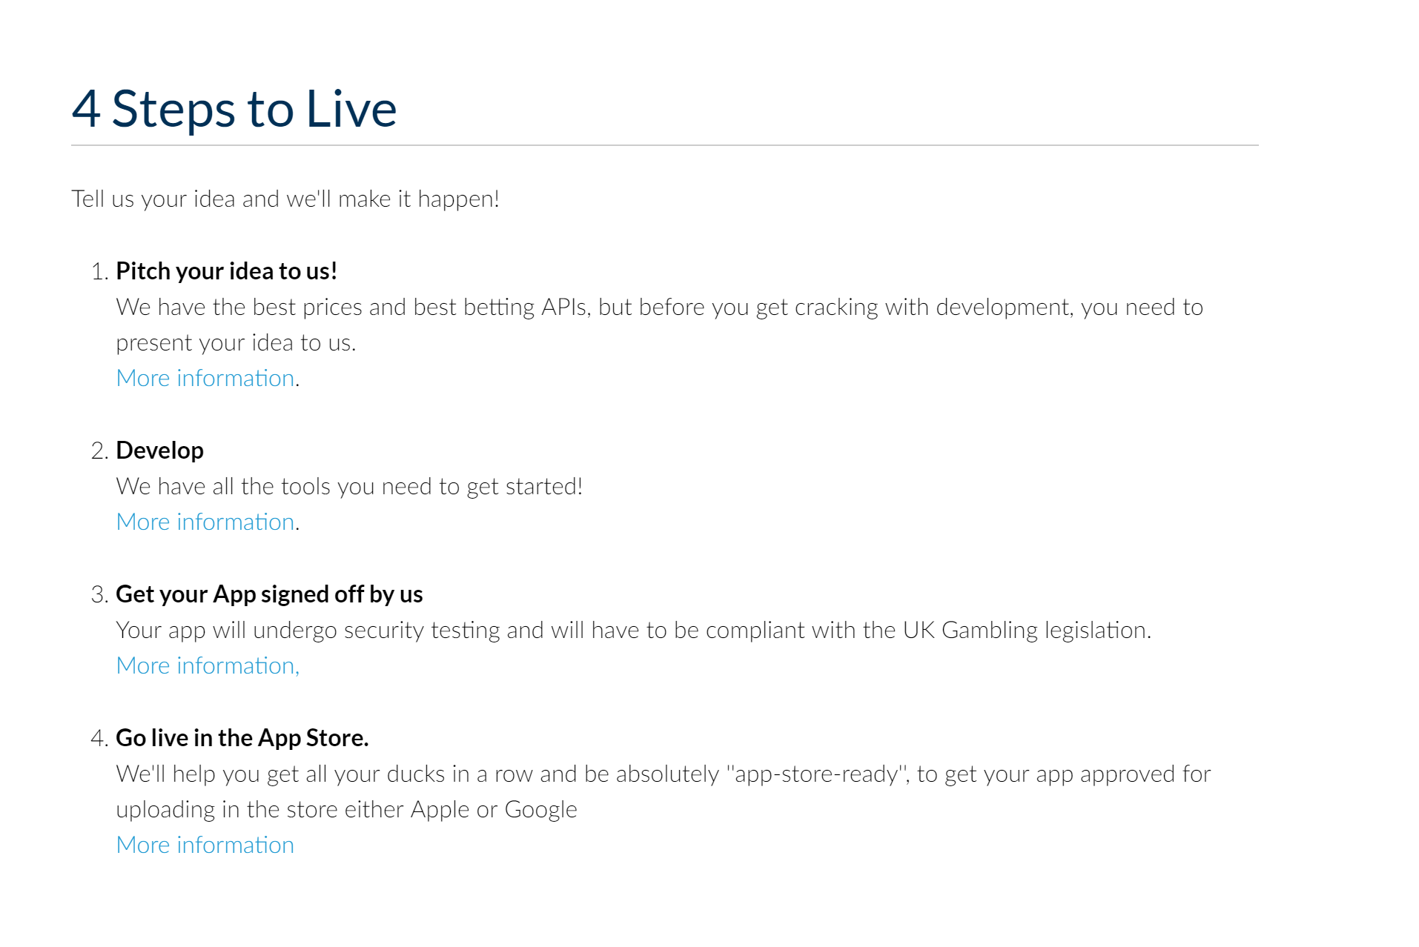
William Hill: Fostering Innovation from the Outside

Slide 113
A William Hill Business Model
earning potential
gamblers
enjoyment
branches
apps
3rd Party apps

Slide 114
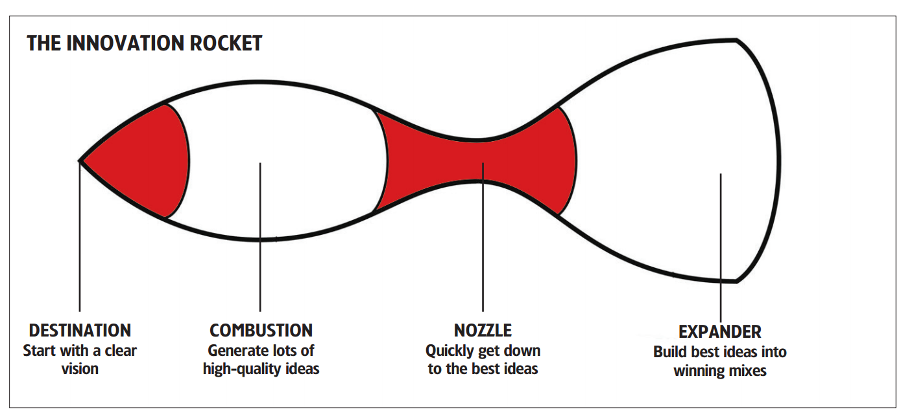
Innovation Funnels and Rockets
APIs are for innovation intake – but not enough on their own
Targeted innovation can improve results
Developer audience must be incentivized to participate
David Nichols’ Innovation Rocket
http://thebrandgym.com/downloads/bgym%20Market%20Leader%20Innovation%20Rocket%20article%20-%20Sept%2007.pdf

Slide 115
Innovation From The Inside
Ideas generated from our own people
Better idea execution
Get better at changing tech:
Improve cost of making change
Improve rate of change
Improve speed of change

Slide 116

Innovation Case Study

Slide 117
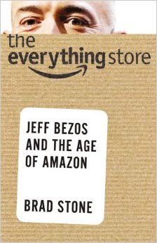
Amazon.com’s Evolution
An online book shop
The Web’s department store
“The Everything Store”

Slide 118
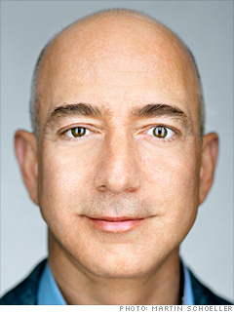
“
If you never want to be criticized, for goodness sake don’t do anything new.
”
Jeff Bezos
Founder of Amazon

Slide 119
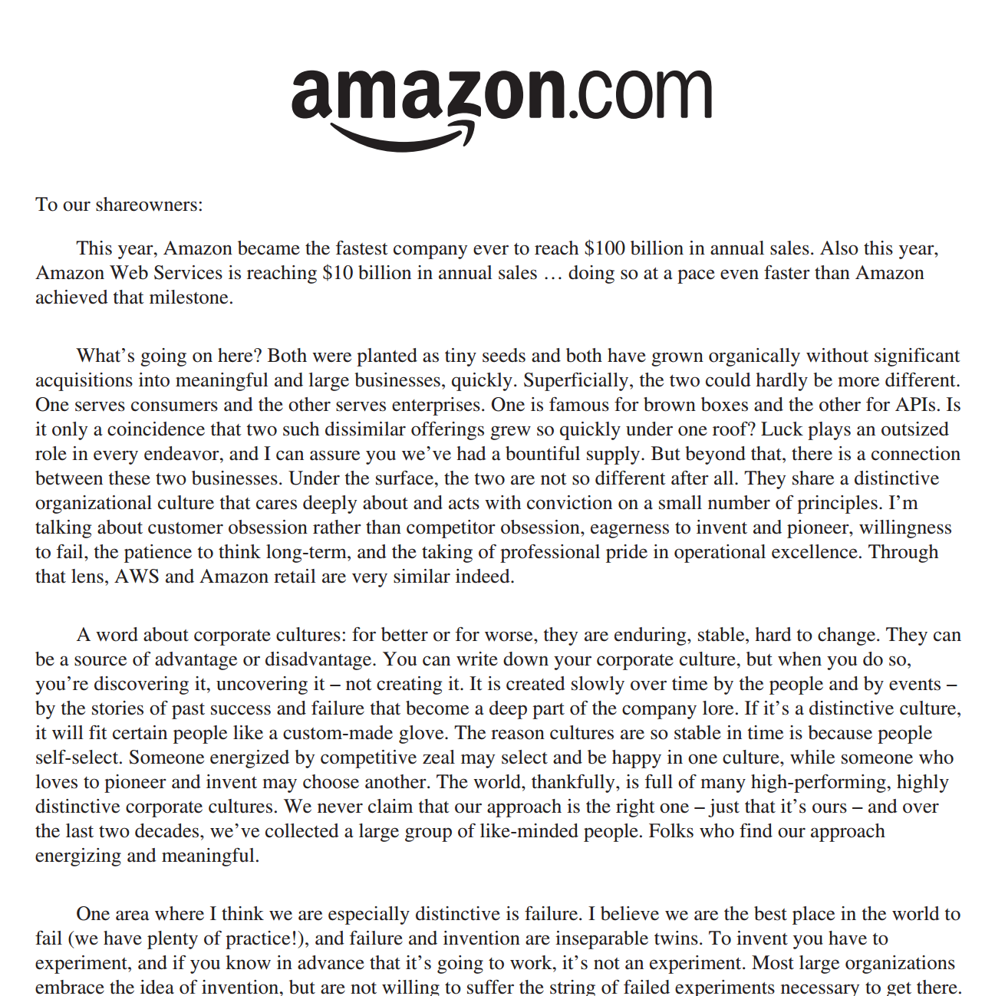
Amazon’s 2015 Letter to Shareholders
“
We want to combine the extraordinary customer-serving capabilities that are enabled by size with the speed of movement, nimbleness, and risk-acceptance mentality normally associated with entrepreneurial start-ups.
”

Slide 120

How did Amazon.com achieve speed and safety?
Amazon became an API-centric company
API
API
API
Notes:
APIs as a platform can foster an environment of innovation. Building blocks.

Slide 121
A Simplified Amazon.com Model
the best
customer
experience
self-service
mass market
website
Commission
And product sales

Slide 122
A Simplified Amazon.com Model
innovation
the best
customer
experience
self-service
mass market
API Platform
website
changes to platforms
Commission
And product sales

Slide 123
A Simplified Amazon.com Model
innovation
the best
customer
experience
self-service
mass market
Infrastructure
software developers
API Platform
website
changes to platforms
Commission
And product sales
subscription

Slide 124
The Innovation Test
How easily can your business teams…
Launch a new mobile app experience?
Engage a boutique app development firm?
Launch a pilot product as an experiment?

Slide 125
COMPLIANCE

Slide 126
API Driver: Compliance
DEFINITION
Mandated API implementation
“How should we comply?”

Slide 127
API Driver: COMPLIANCE
IN BRIEF
If you have to do it, you have to do it
Compliance directives can drive APIs towards commoditization of a market

Slide 128
Compliance Examples
Mergers and acquisitions
Open Data initiatives
Regulatory requirements (e.g. PSD2)
Notes:
There are three types of compliance driven APIs that we will talk about

Slide 129



APIs are needed to make data more consumable
Client Applications
APIs
Open Data
Notes:
Over time the need for easier access to the data has become important and now there is a growing ecosystem of companies who add a consumability layer on top of the data provided by the public sector. Governments themselves are also focusing on Apis more than they did previously.

Slide 130
Compliance: Cost-Benefit
Driver | Meet Requirements | Exceed Requirements
M&A | One time data-merge, big-bang cutover | API for continued inter-op.
Open Data | Export data file | Provide API
Regulatory | Email/file transfer | API for on-demand reporting
Do as little as possible
Increase compliance while minimizing cost

Slide 131
Compliance API Commoditization
PSD2 API
PSD2 API
PSD2 API

Slide 132
Compliance API Commoditization
PSD2 API
PSD2 API
PSD2 API
Unique Value API

Slide 133
INTELLIGENCE

Slide 134
API Driver: Intelligence
DEFINITION
The API as a vehicle for data collection
Data Sources:
Users
Applications
Systems
“How can we collect more and better data?”

Slide 135
API Driver: INTELLIGENCE
BRIEF
An API can facilitate intelligence gathering activities
Focus on 3rd party applications that will reach target audiences
Identify value proposition for these 3rd parties

Slide 136
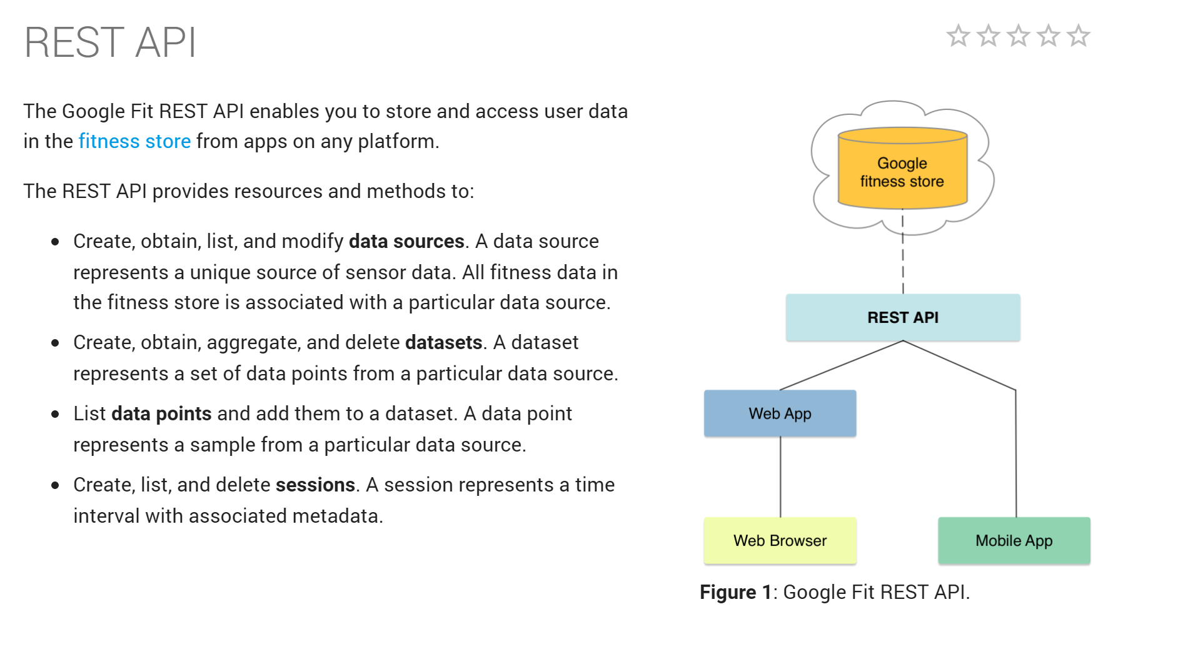

Intelligence Case Study

Slide 137
A Google Fit API Business Model
fitness tracking
portal
developer
API
data collection

Slide 138

A Google Fit API Business Model
fitness tracking
portal
developer
user data
advertisers
API
API
advertising sales
data collection

Slide 139

Amazon: Crowd sourcing price data
Notes:
Value: find cheapest price
Data: competitor’s prices

Slide 140
APIs for Analytics
Which requests are invoked most frequently?
Where do most requests come from?
In what order are requests made?
Which features are consumers using the most?
Which platforms/geos are the most popular?
Which behaviour’s lead to purchases?
Notes:
The advantage to using an API for this type of analytics:
We can avoid installing custom software onto the user’s client platform
The request data is centralized. We only need to look in the API platform to mine data – no need to aggrete and translate.
Data mining doesn’t require API platforms but as with many things, APIs make data mining easier and cheaper.

Slide 141
Amazon utilizes all six drivers
Notes:
Amazon uses APIs for all of the motivators we have discussed. You don’t need to choose one – but you do need to decide why you are doing it.

Slide 142

NPR’s API drivers have evolved
API created to foster external & open innovation
The API evolved to support integration with local stations
Now the API is central to NPR’s mobile and IoT strategy
Notes:
Notes from a phone call with Irakli:
Media company
* API started in 2008 (pre-dates Irakli)
* Daniel Jacobsen started it.
* One of the first media organiations to have an API
* Started out of curiousity (joke: was no CEO, imlemented inbetween CEOs)
* Original reason was innovation driven (thousands of flowers)
* NPR windows application exists because of the API
* usage by 3rd party was ~3%
* innovation driven was a failure
* but, NPR is very de-centralized and the driver shifted to reach
* NPR is a collection of 3000 independant stations
* Local stations usually buy programming from NPR (e.g. morning and evening commute)
* flagship programs are produced by NPR, local stations buy and produce
* The API ended up being important for content exchange between stations and the NPR hub
* RSS was very important at that time because many of the stations could only produce an RSS feed
* Once mobility and IOT happened, NPR found that they needed to reach customers (platform is more important than provider )
* Very rapid loyal fan base, but even these listeners were choosing competitors if NPR wasn't available on the platform they were using
* car platforms had to be supported
* API platform outgrew itself (public media platform)
* NPR API was stringent, NPR was able to dictate the rules, it was inflexible
* NPR wanted to integrate with other public media networks, but it couldn't exert as much control, it had to be more flexible
* this is what triggered the hypermedia API, etc.
* The API was extended during each phase
* "APIs allow you to take your analog business models and make them digital." -- Irakli
* "what are you really telling your cusotmers, the API is the interface to your company"

Slide 143


https://hbr.org/1999/03/unbundling-the-corporation

Slide 144

Which API Business Will You Focus On?
Focus on Customer Relationship
Large invest in application development
Use UX as a differentiator, provide niche experiences
Deploy private, app-centric APIs to reduce cost
Financial Platform
Notes:
This is mostly a cost reduction play from an API perspective. Can you design an API platform that makes it easier and cheaper to build new experiences? Can acquisitions and acquihires be easily integrated into your shop? In this play, commoditization of the financial platform is fine, because you are focusing on the UX, but note that there may be a lower barrier to entry here, so expect lots of competition from both small and big players.

Slide 145
Which API Business Will You Focus On?
Focus on Infrastructure Platform
Large Invest in platform as a product
Offer unique API function and high API usability as a differentiator
Compete for app developers
Financial Platform
Notes:
Focusing on the platform can be a smart play because of the high cost of entry and difficulty in dealing with regulatory and legal pressures. This play requires both a volume and innovation led effort. You are competing for the best app developers, so you will need to offer a competing value proposition for them. You may opt to preserve a consumer relationship, in which case you may need to build branding requirements into the integration deal. Building an ecosystem of app devs who target your main end user audience is crucial here.
If PSD2 commoditizes this market, you will need to offer unique value propositions (innovation-driven) or compete on price alone (volume-driven). The bank should be able to make money in either case.

Slide 146
Building An API-Centric Innovation Platform
Notes:
What are we really talking without about here?

Slide 147
Building an API-Centric Innovation Platform
THE IDEA IN BRIEF
Business innovation can be fostered with increased changeability in technology platforms
Improving changeability requires an adaptive, holistic, system focus rather than a deterministic, IT focus
Boundary Setting is emerging as a critical skill for technology platform designers

Slide 148
Driving Innovation
qty
cost
Idea Generation
Idea Execution

Slide 149
OUTSIDE
IMPLEMENTATION
API
developer-centric interface

Slide 150

INSIDE
IMPLEMENTATION
service
service
Legacy
System
service
API
gateway
service
Data
service
service

Slide 151


Speed and Safety at Scale and in Harmony
The Microservices Way:

Slide 152

Speed and Safety at Scale and in Harmony

Slide 153



We Want Change and We Want it Now
Business Models
Experiences
Products
Notes:
WWAD
WWND
It’s all about release

Slide 154


What Would Amazon Do?
Business Models
Experiences
Products
Notes:
WWAD
WWND
It’s all about release

Slide 155



Business Models
Experiences
Products
Applications
Data Models
Architecture
Notes:
WWAD
WWND
It’s all about release

Slide 156

What Would Netflix Do?
Applications
Data Models
Architecture
Notes:
WWAD
WWND
It’s all about release

Slide 157
Examples of Increasing Speed
Zero beuracracy, don’t ask for permission
Zero validation, don’t test anything
Increase change frequency
Higher faster programmers
Use un-constrained languages and tools
Change production directly

Slide 158
Speed and Safety at Scale and in Harmony

Slide 159
Examples of Increasing Safety
Strong governance, control everything
Always validate, test everything
Reduce change frequency
Higher safer programmers
Use constrained languages and tools
No access to production environments

Slide 160
Speed and Safety at Scale and in Harmony

Slide 161
The Scaling Factor
A changes in size can have a big impact on our system:
Scaled demand
Scaled distance
Scaled organizations

Slide 162
Speed and Safety at Scale and in Harmony

Slide 163
Speed
Safety
Autonomy
De-centralization
Embrace Risk
Control
Centralization
Avoid Risk

Slide 164

Trade-Offs
Speed
Safety

Slide 165

Harmony
Speed
Safety

Slide 166
Harmony
“Cheating” the speed-safety trade-off:
Introduce automation
Change process and tooling
Alter the organizational design
Improve the architecture
Design the culture
Move the change boundaries

Slide 167

API
deterministic
behaviour
adaptive
behaviour
Notes:
The frequency of the lifecycle is bound by how the products we create are consumed

Slide 168
API
Notes:
We could achieve emergence
This would help with lifecycle frequency, less risk of changes

Slide 169
decision space
supporting services
work item
team
service
tool & platform space
infrastructure
Notes:
Each of these bounds live in a different ‘dimension’, but bouding decisions about each domain have an impact on other parts

Slide 170
decision space
supporting services
work item
team
service
infrastructure
tool & platform set
Notes:
Each of these bounds live in a different ‘dimension’, but bouding decisions about each domain have an impact on other parts

Slide 171
Adaptive
decision space
supporting services
Non-Adaptive
work item
team
service
tool & platform space
infrastructure
Notes:
Each of these bounds live in a different ‘dimension’, but bouding decisions about each domain have an impact on other parts

Slide 172
What makes technology systems resistant to change?
Co-ordination requirements are too high
Change is laborious
Risk aversion reduces change speed

Slide 173
Emerging Trends
 | Lighter Co-ordination | Labour Reduction | Risk Reduction
Solution (macro) | De-Centralization | Evolvability | Adaptiveness / “Anti-Fragility”

Slide 174
Emerging Trends
 | Lighter Co-ordination | Labour Reduction | Risk Reduction
Solution (macro) | De-Centralization | Evolvability | Adaptiveness / “Anti-Fragility”
Service (micro) | Bounded Contexts | Implementation Autonomy | Independent Deployment

Slide 175
Emerging Trends
 | Lighter Co-ordination | Labour Reduction | Risk Reduction
Solution (macro) | De-Centralization | Evolvability | Adaptiveness / “Anti-Fragility”
Service (micro) | Bounded Contexts | Implementation Autonomy | Independent Deployment
Process and Tools | Smaller Units of Work | Increased Work Automation | Increased Test Automation

Slide 176
Emerging Trends
 | Lighter Co-ordination | Labour Reduction | Risk Reduction
Solution (macro) | De-Centralization | Evolvability | Adaptiveness / “Anti-Fragility”
Service (micro) | Bounded Contexts | Implementation Autonomy | Independent Deployment
Process and Tools | Smaller Units of Work | Increased Work Automation | Increased Test Automation
Culture | Trust | Tool Making | Accountability & Responsibility

Slide 177
Emerging Trends
 | Lighter Co-ordination | Labour Reduction | Risk Reduction
Solution (macro) | De-Centralization | Evolvability | Adaptiveness / “Anti-Fragility”
Service (micro) | Bounded Contexts | Implementation Autonomy | Independent Deployment
Process and Tools | Smaller Units of Work | Increased Work Automation | Increased Test Automation
Culture | Trust | Tool Making | Accountability & Responsibility
Organization | Smaller Teams | Increased Autonomy | Skilled Workers

Slide 178
Three Innovation Architecture “Dials”
Boundary Definitions
Established Standards
Co-ordination Mechanisms

Slide 179
The Costs of System Optimization (Examples)
Increased Automation == Higher cost to change existing machinery
Increased Autonomy == Increased requirement for skilled workers
Smaller Boundaries == Increased cost of co-ordination and management

Slide 180

Service
(micro)
Solution
(macro)
Process
and
Tools
Organization
Culture

Slide 181
SEB Executive Briefing on API Strategy
Ronnie Mitra
Director of Design
ronnie.mitra@ca.com
@mitraman

